Slide 1

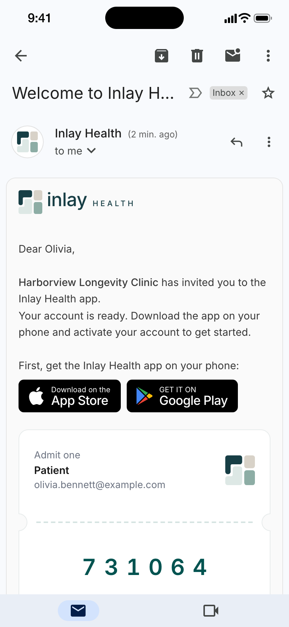
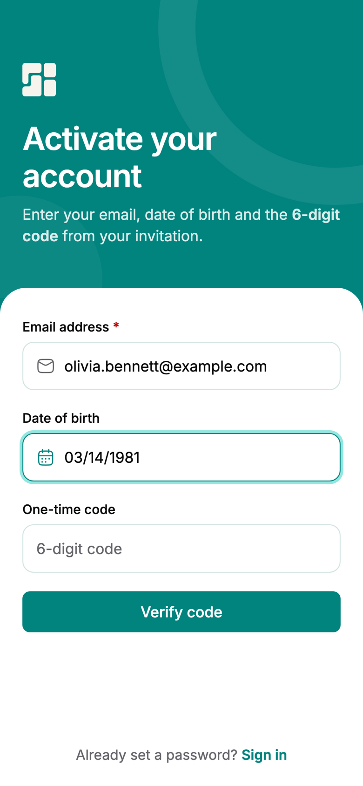
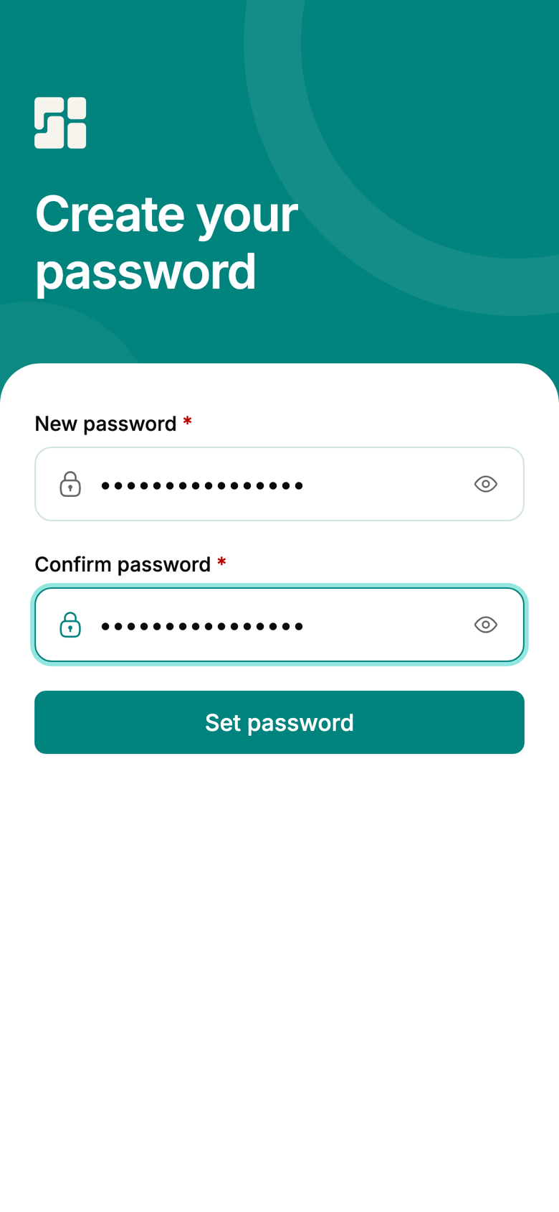
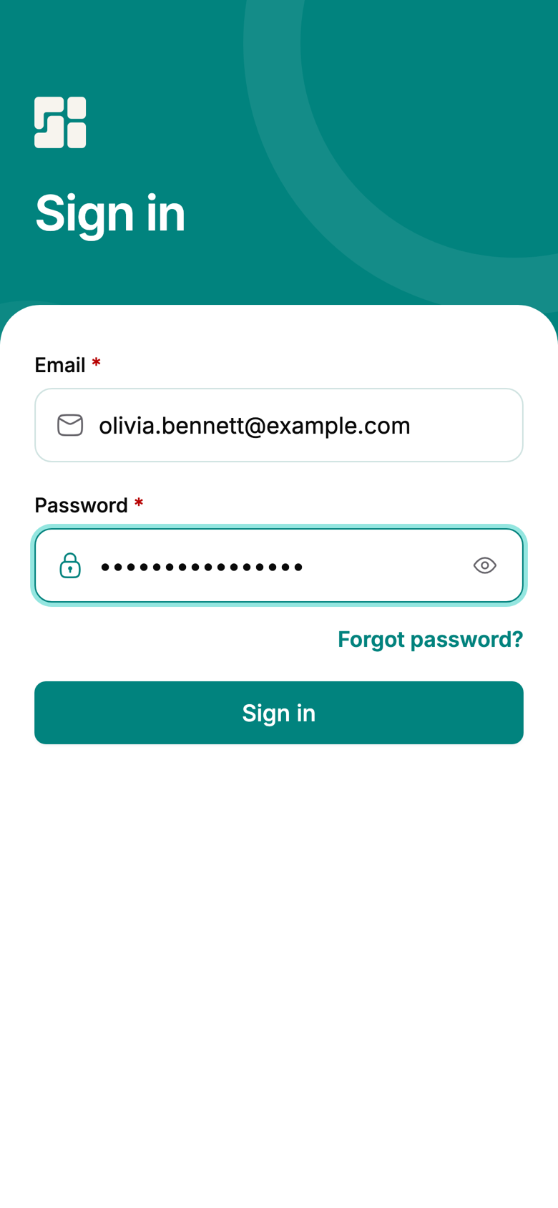
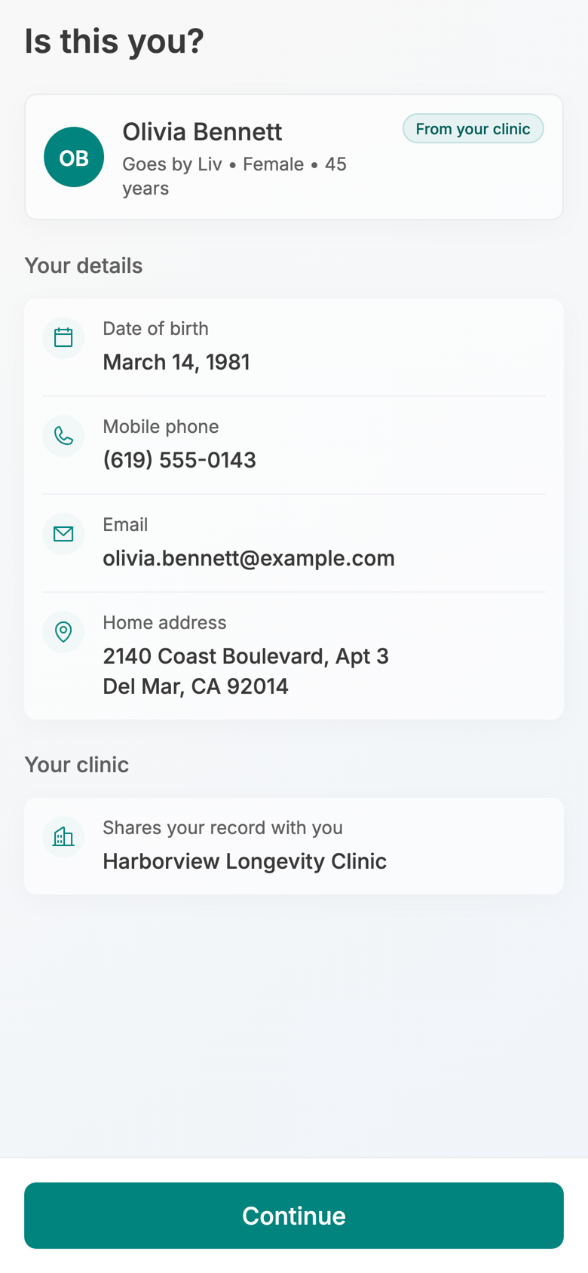
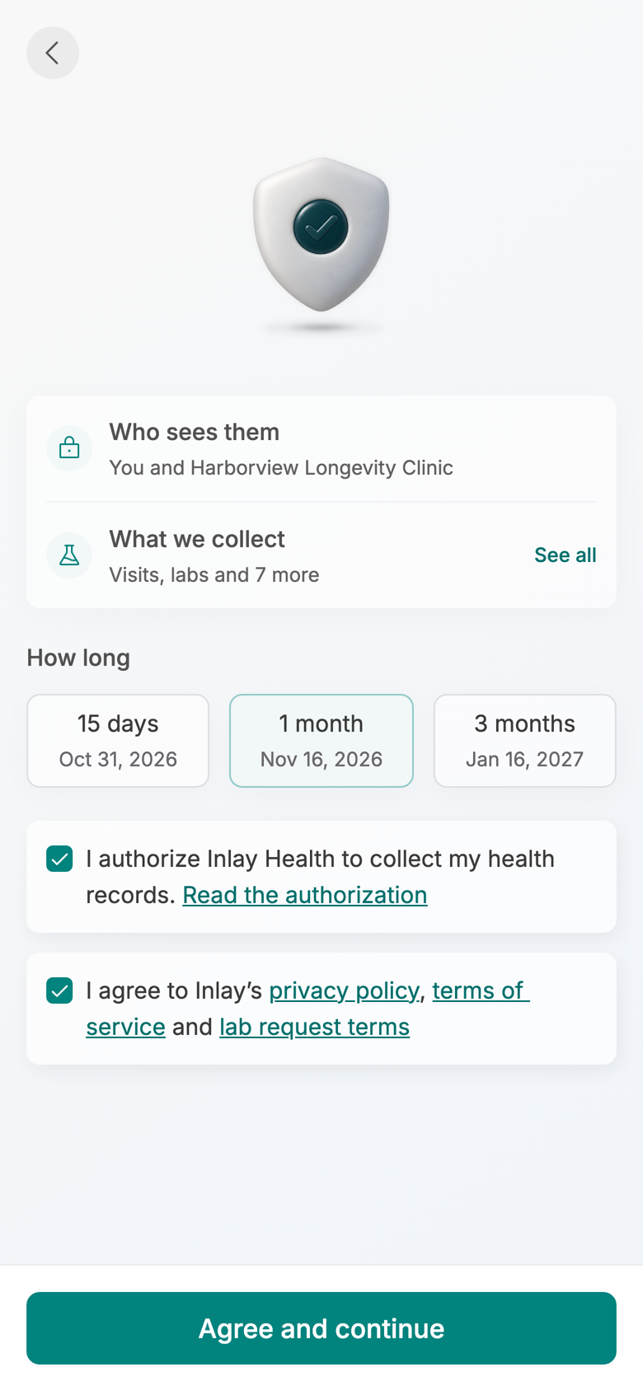
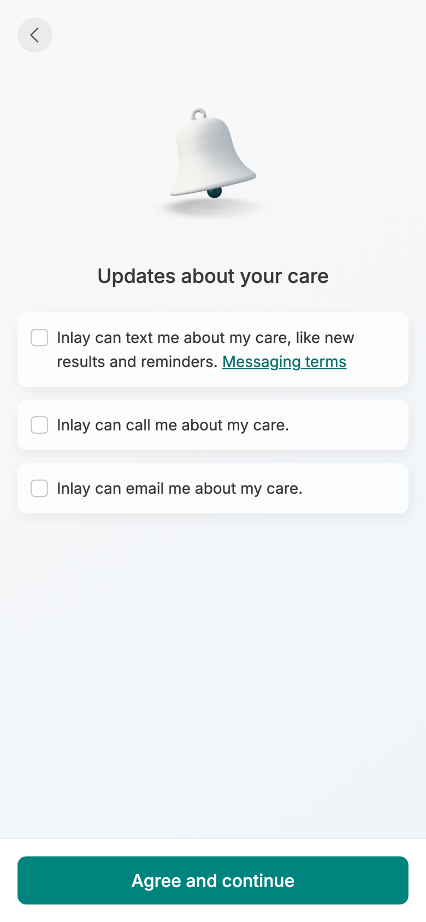
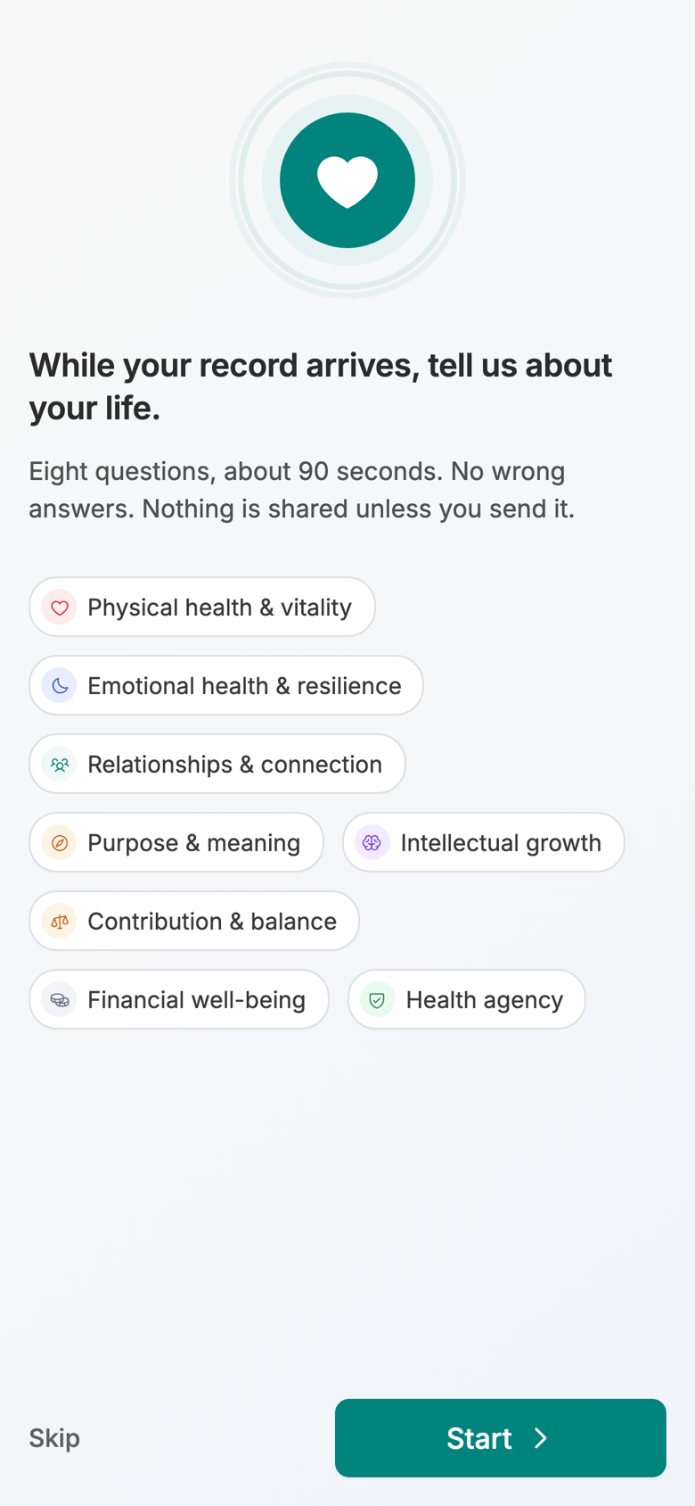
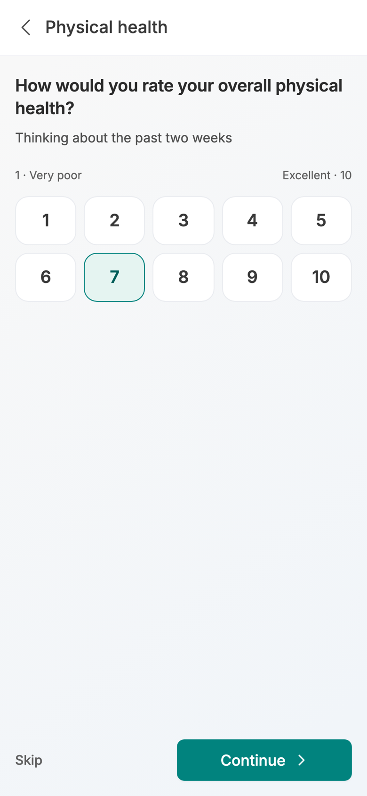
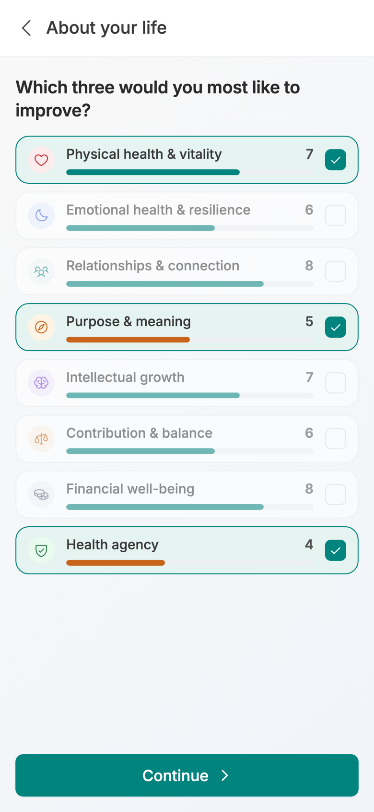
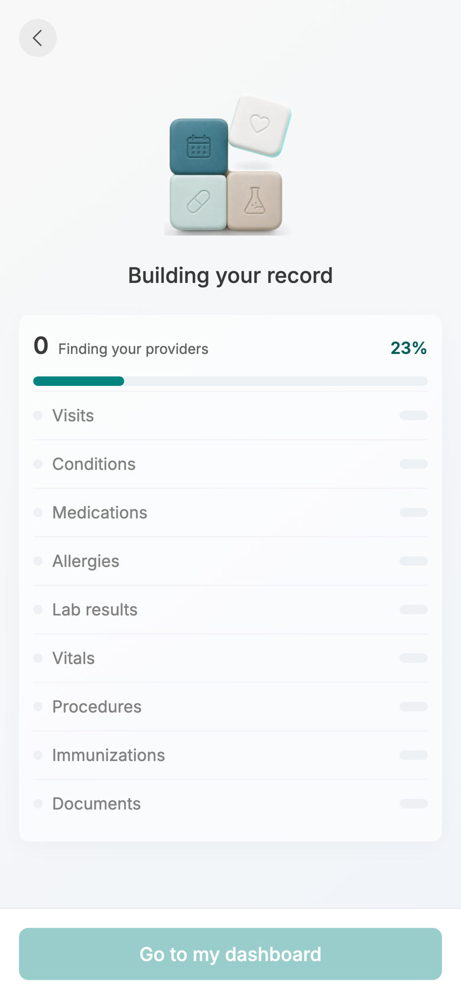
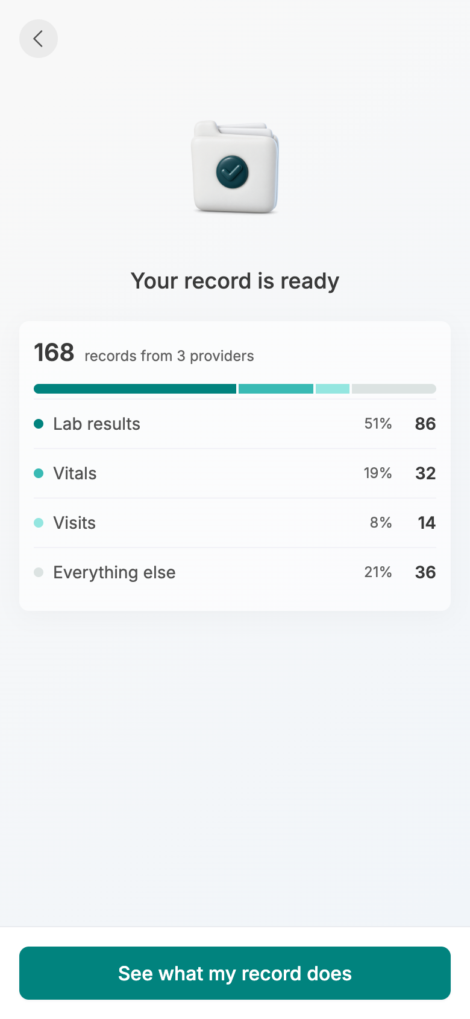
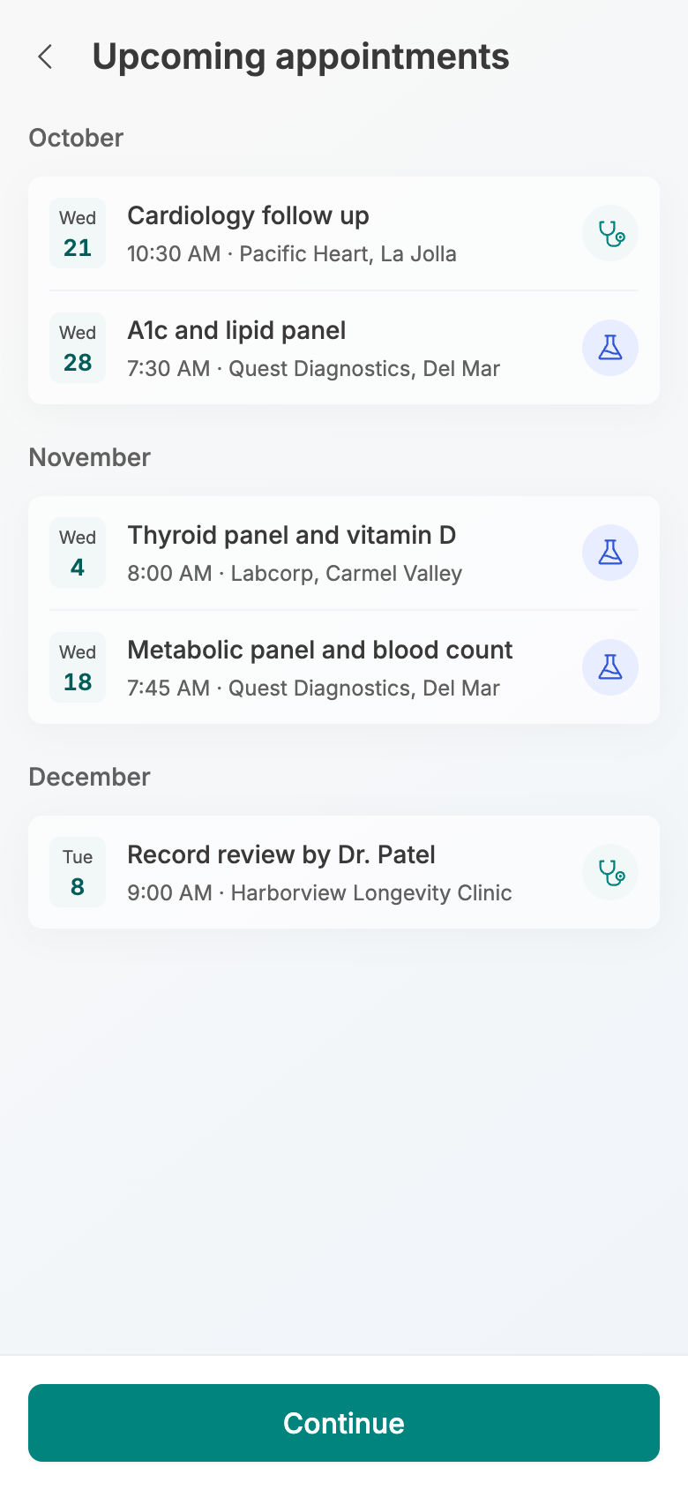
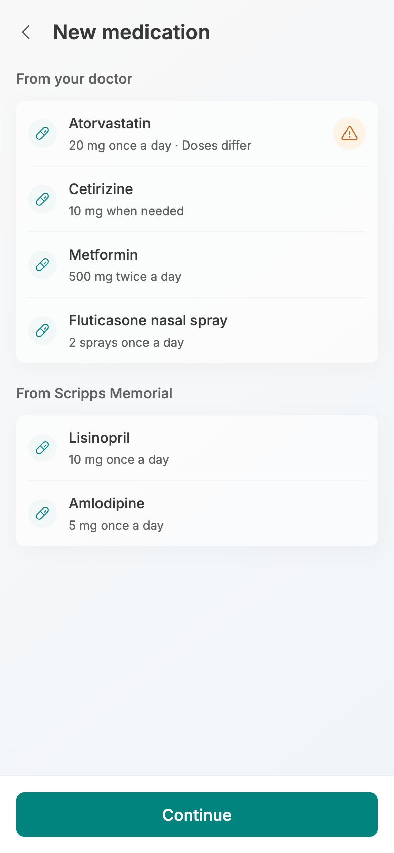
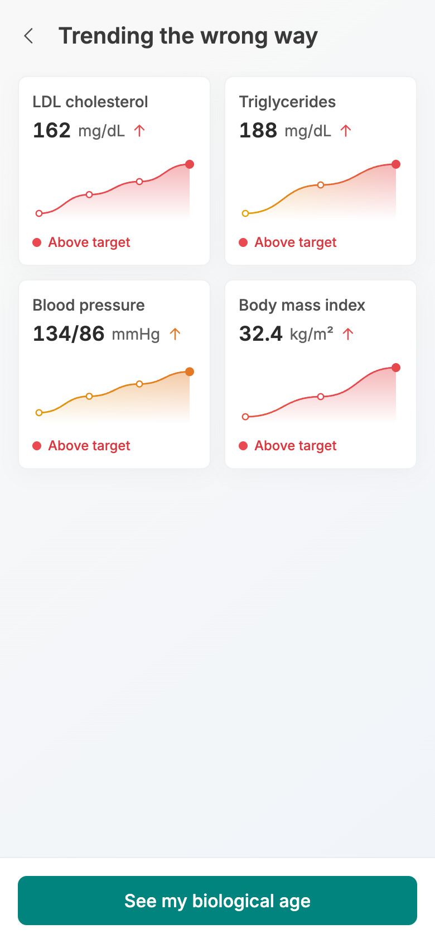
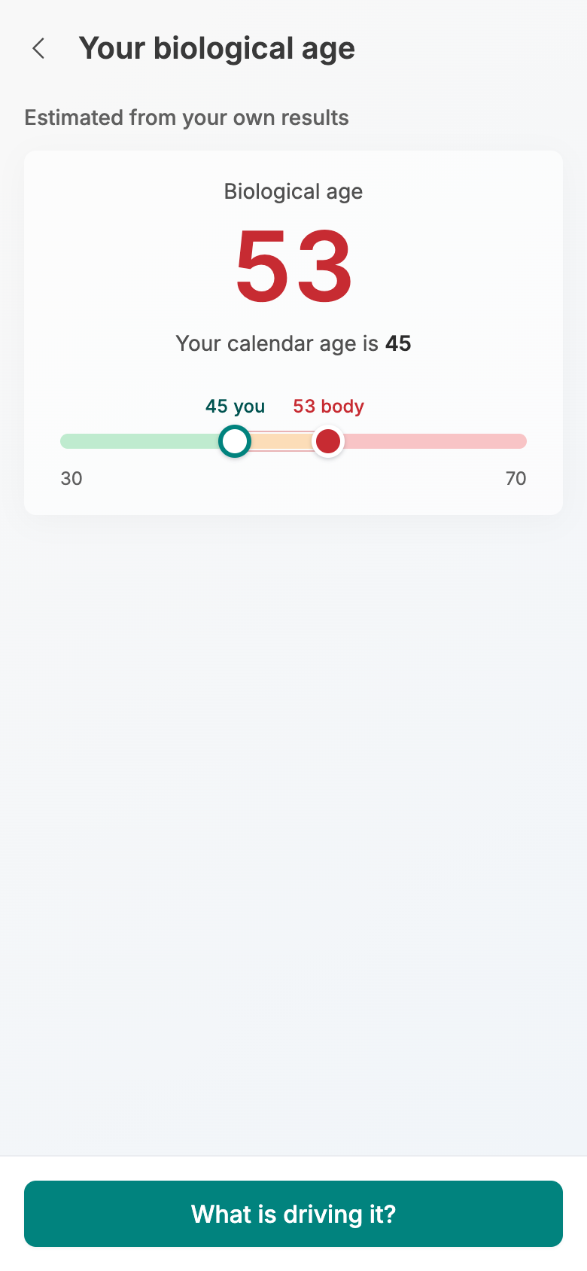
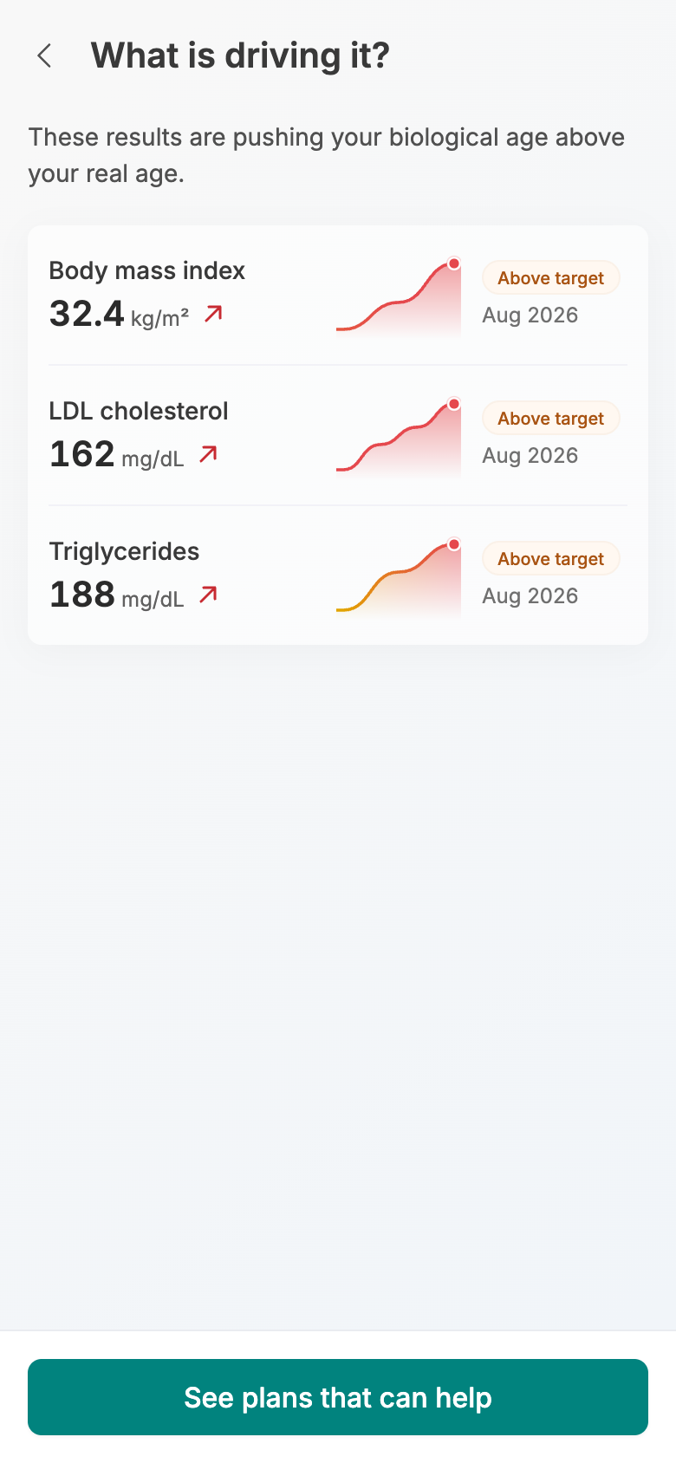
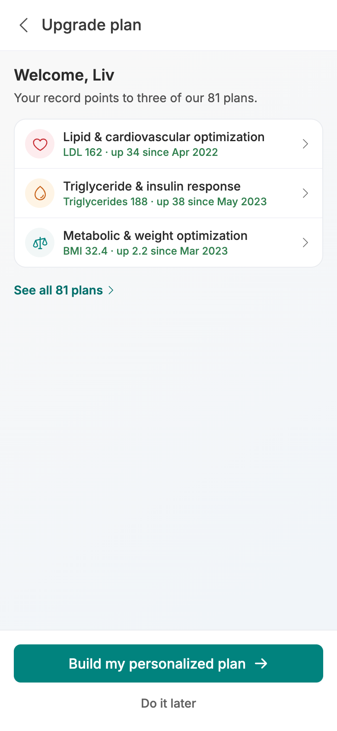
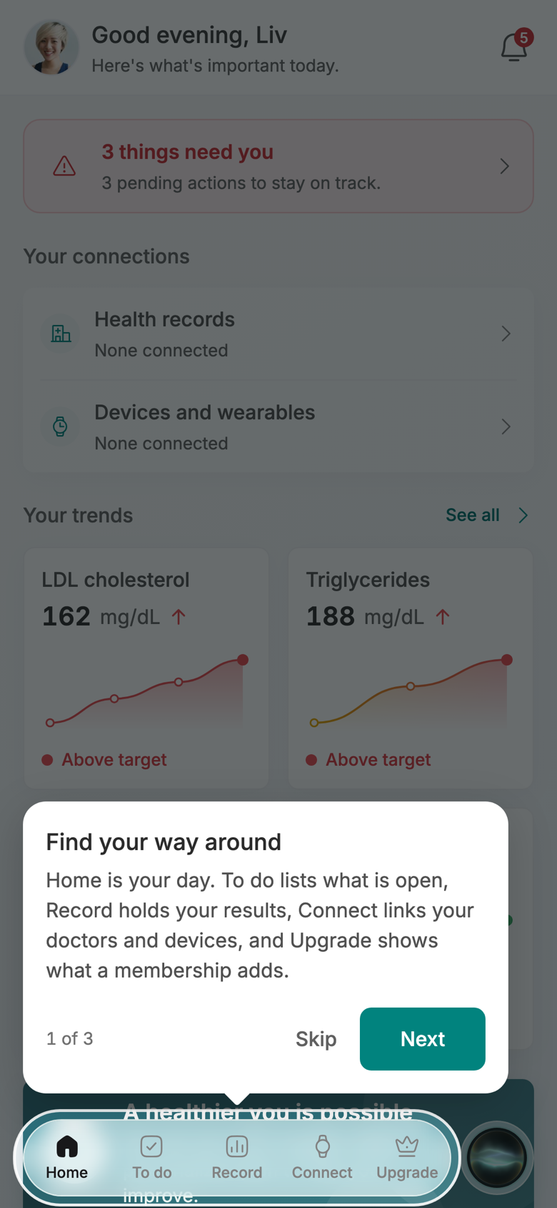
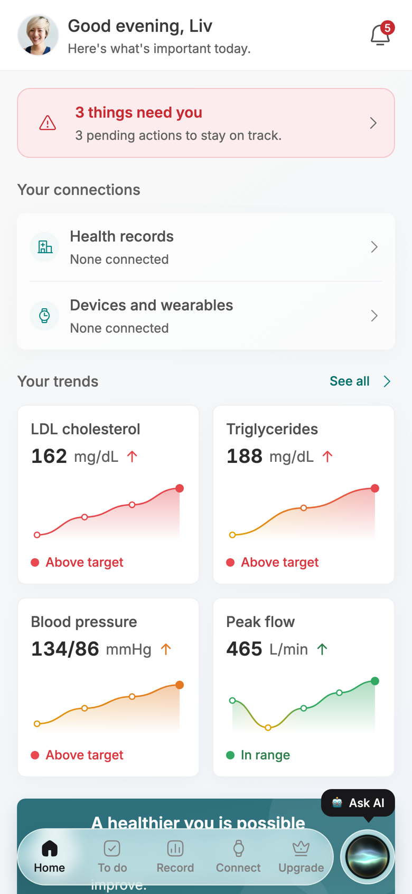
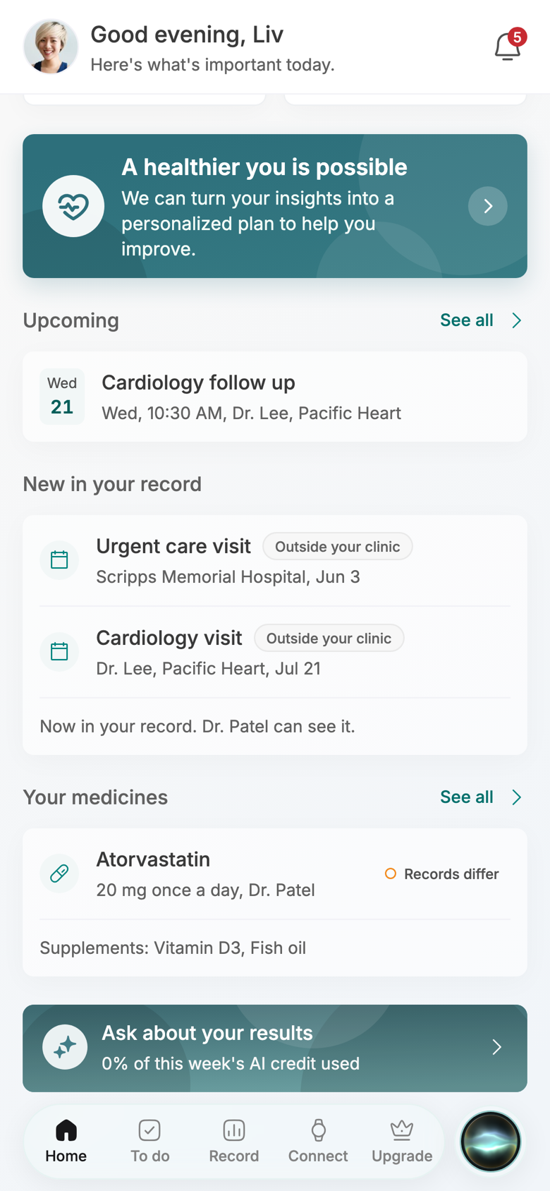
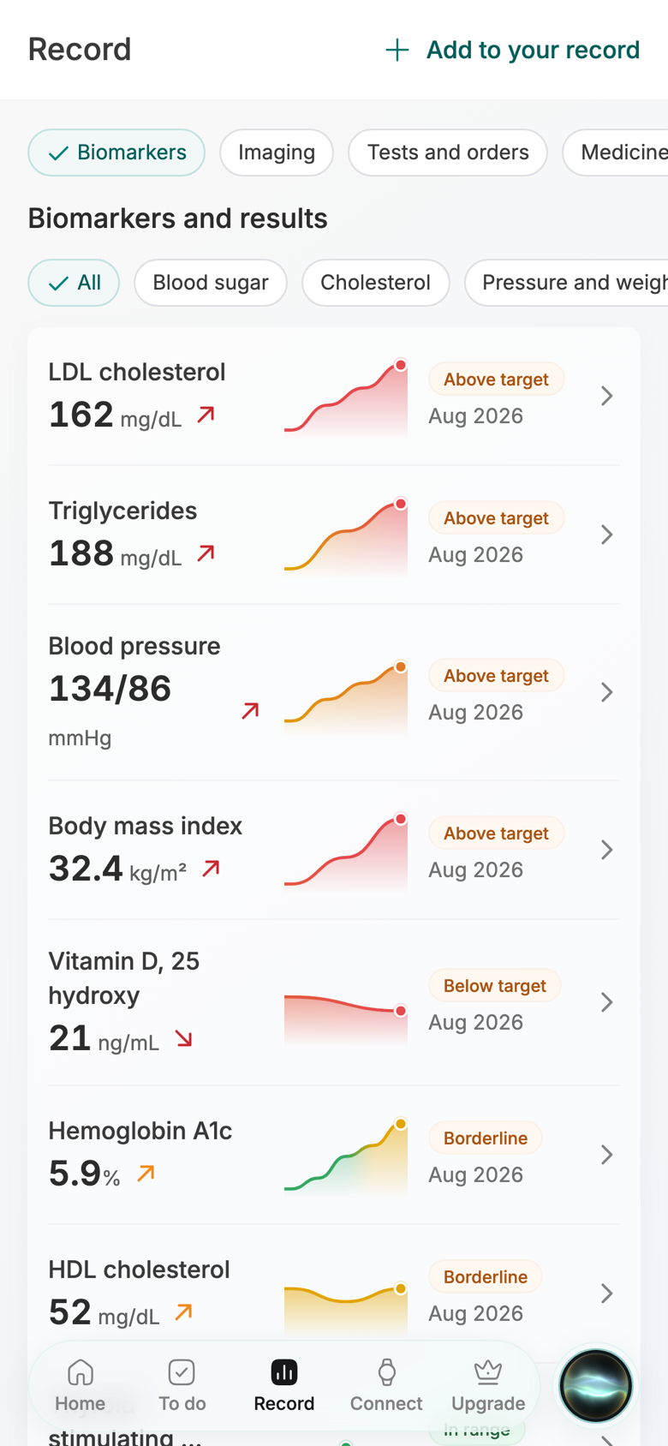
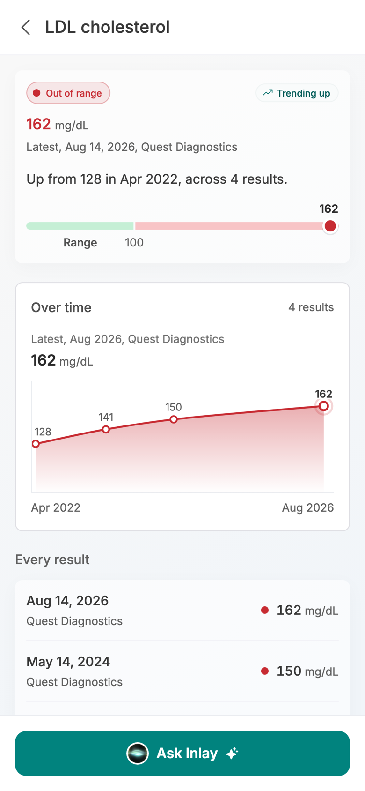
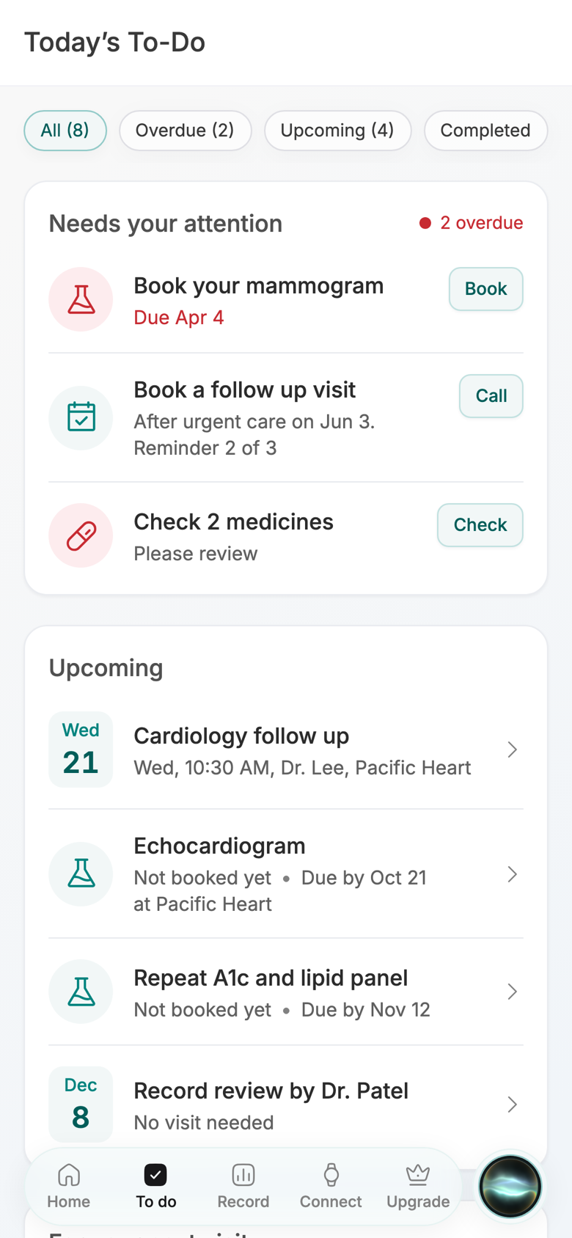
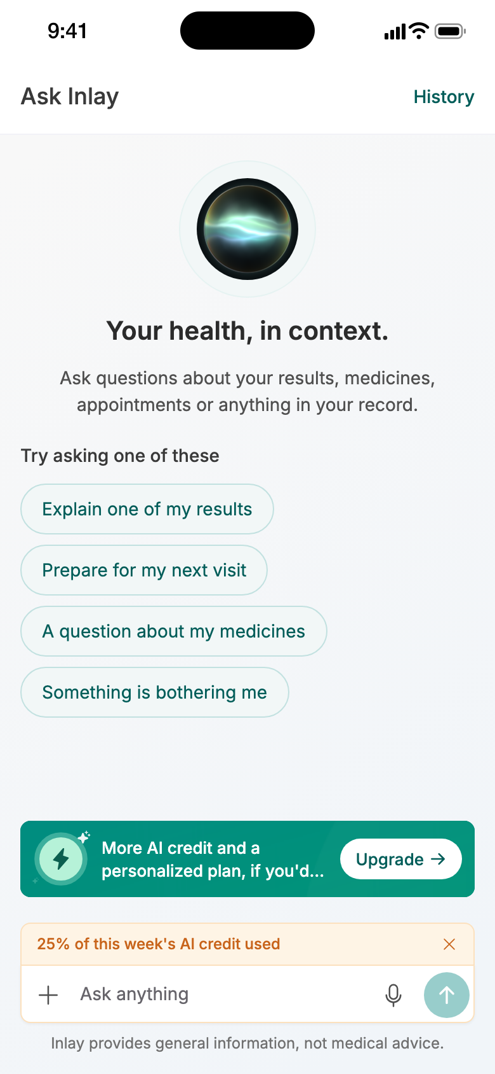
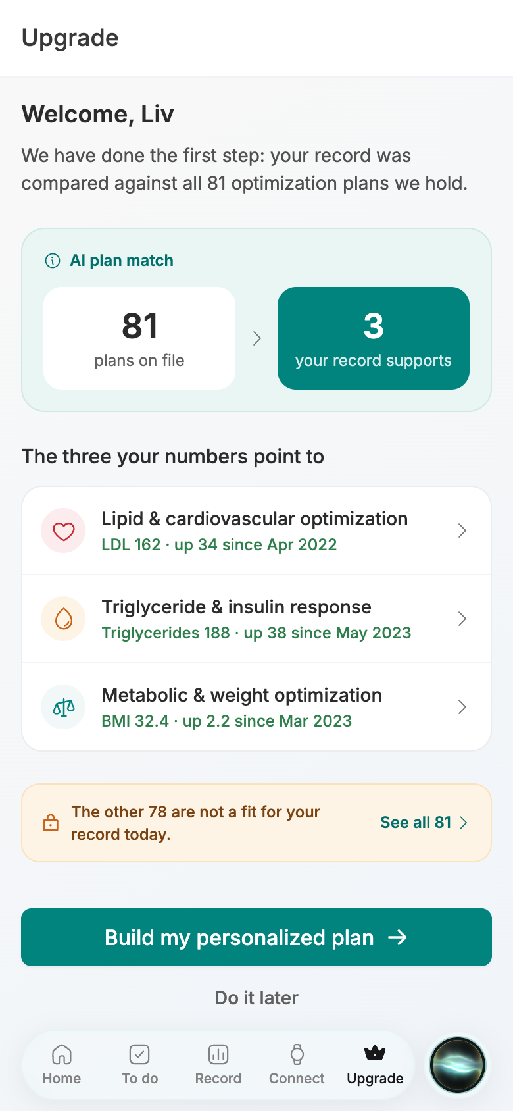
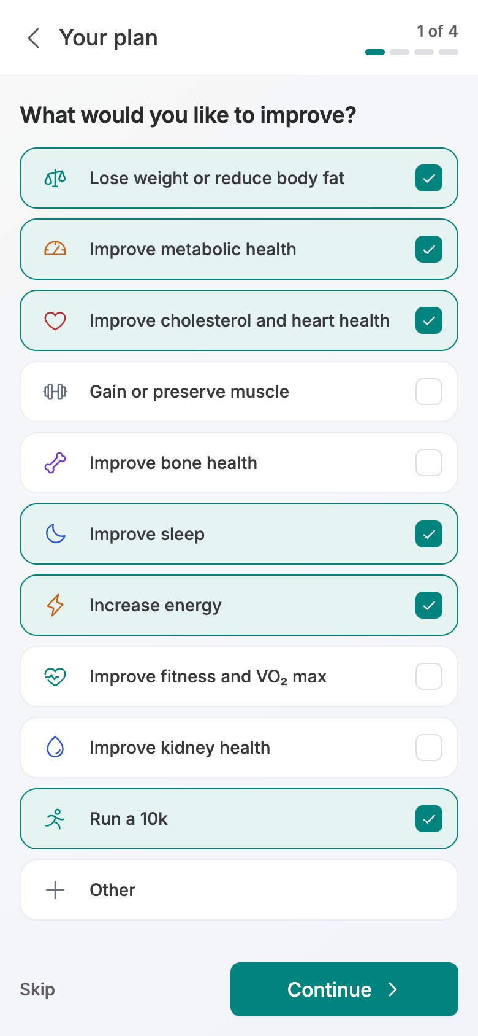
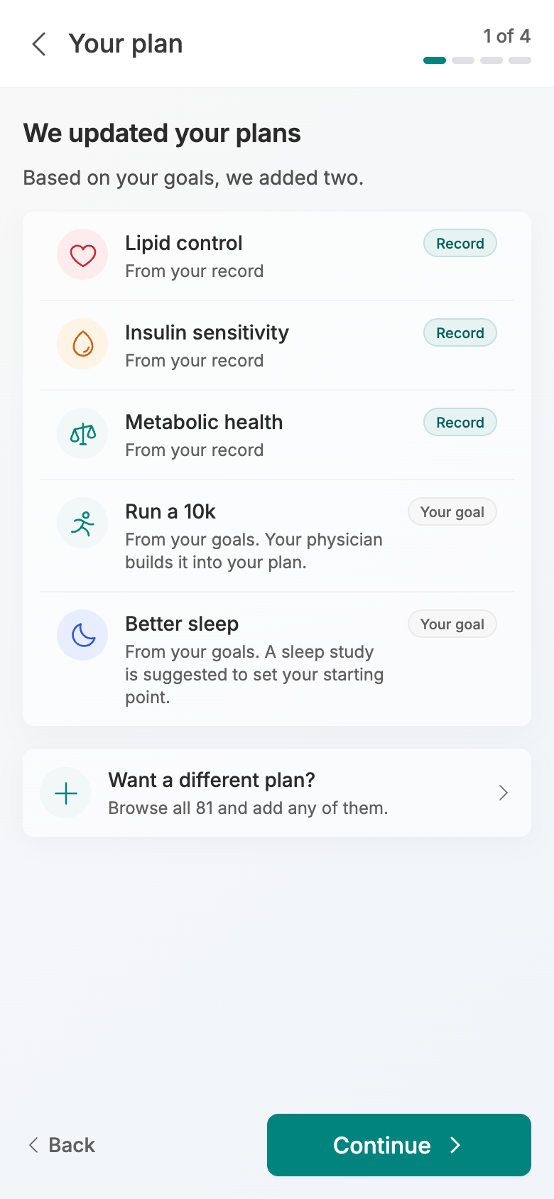
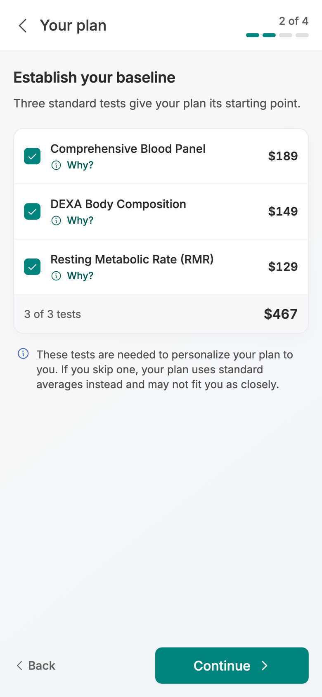
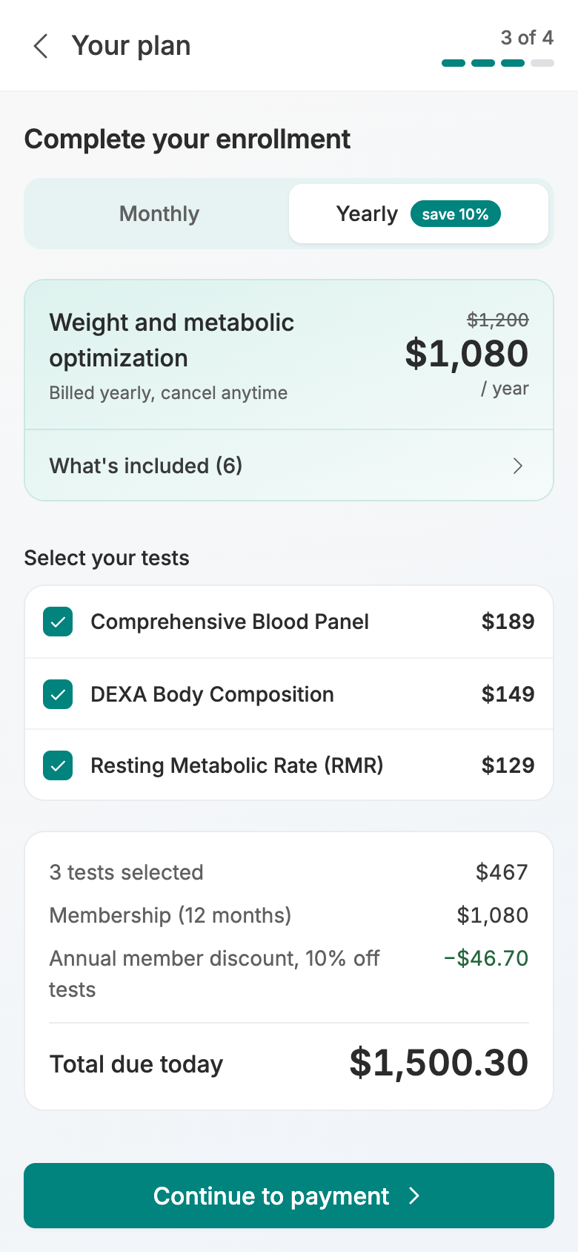
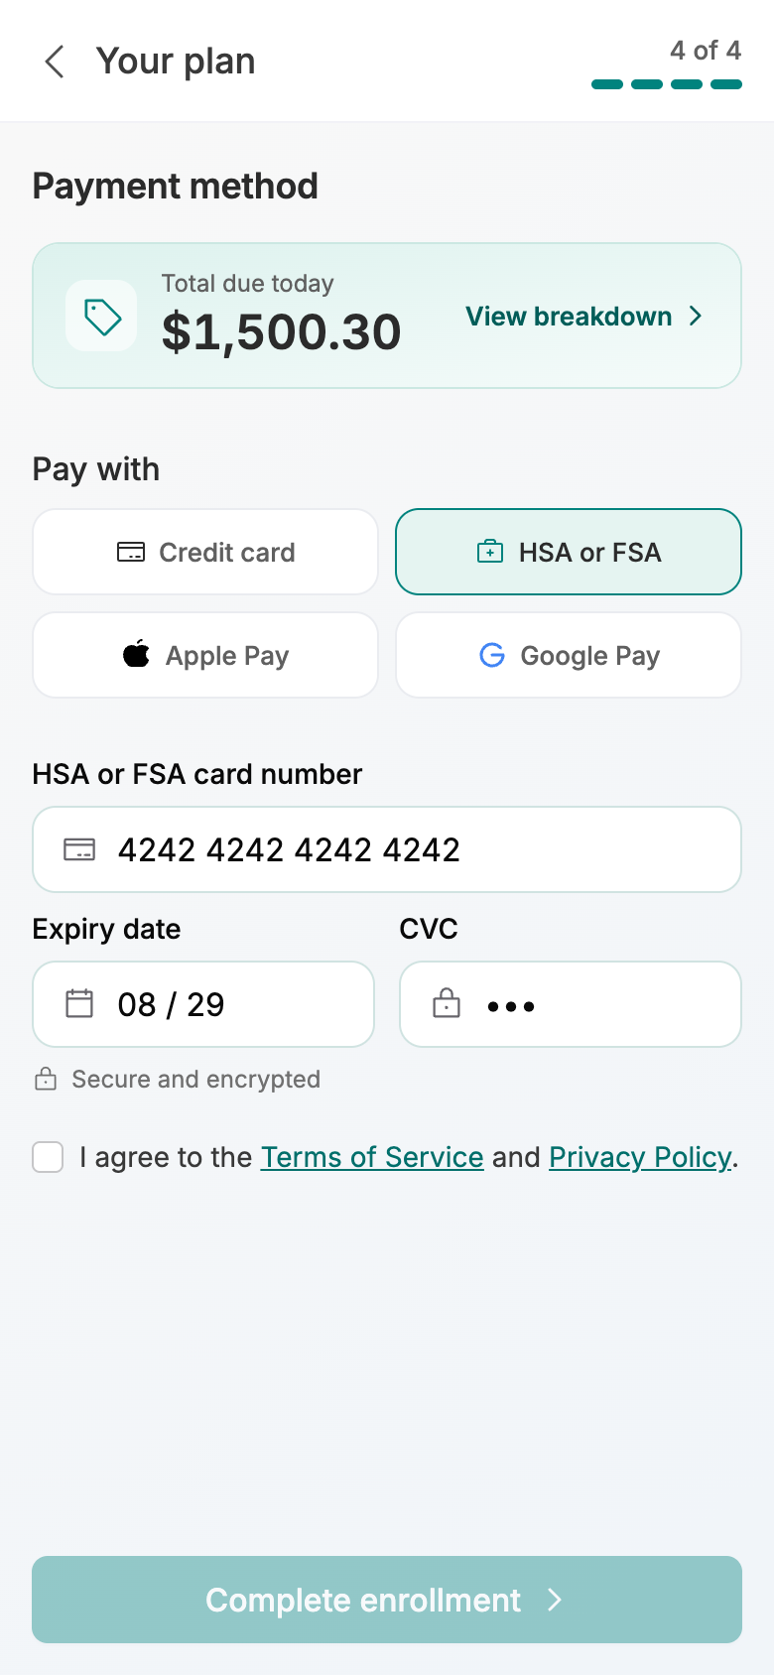
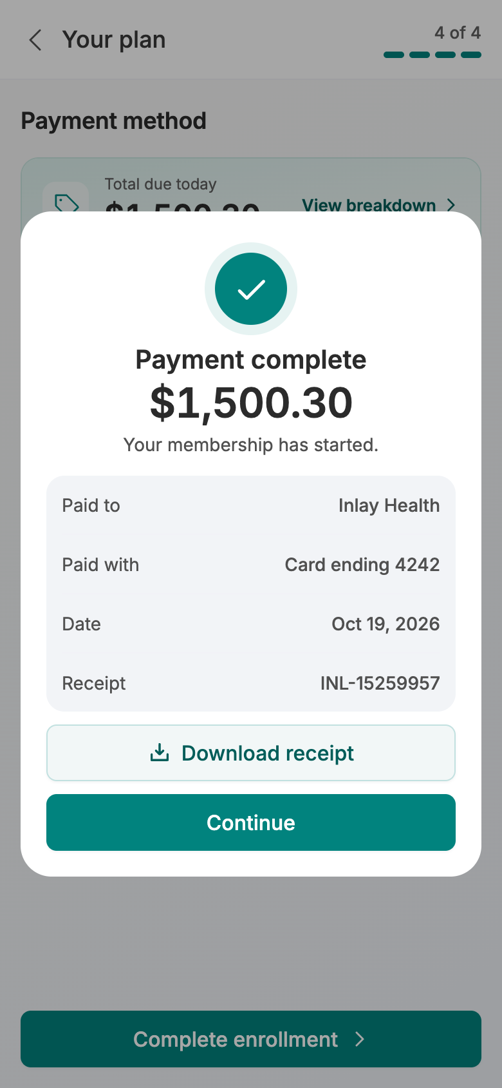
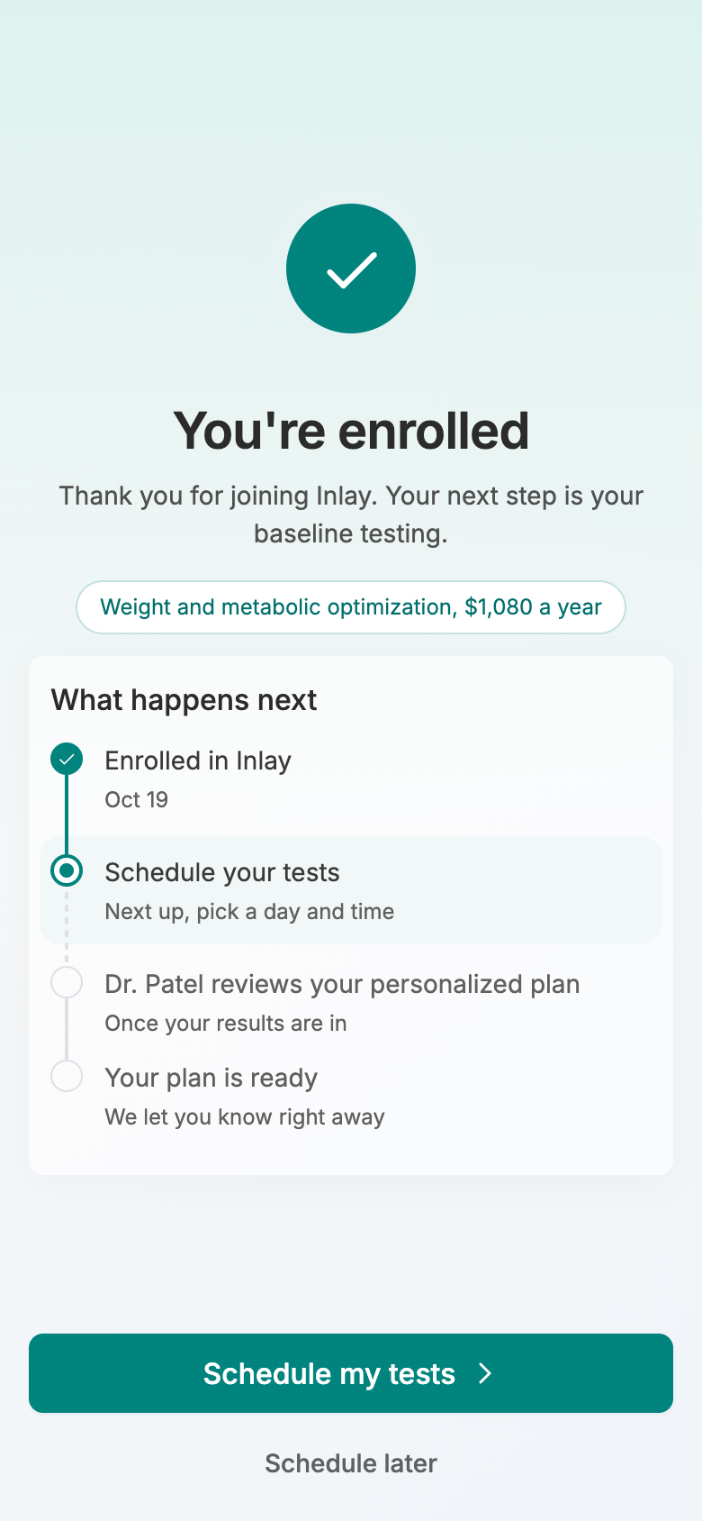
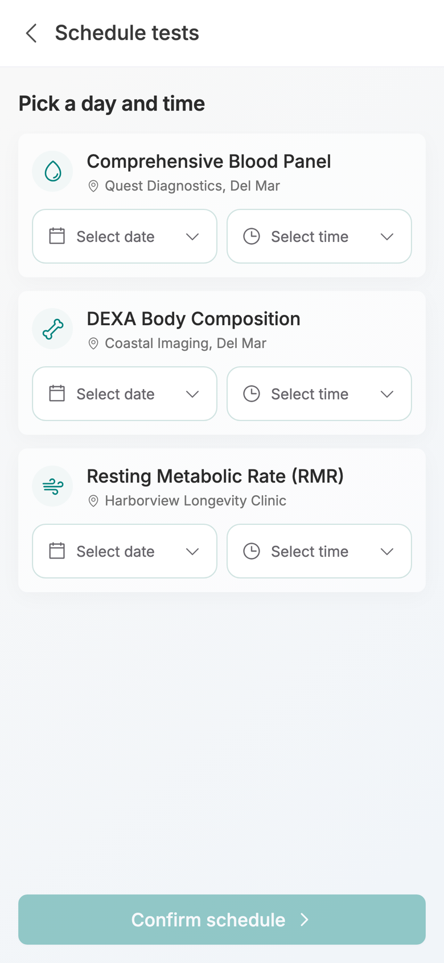
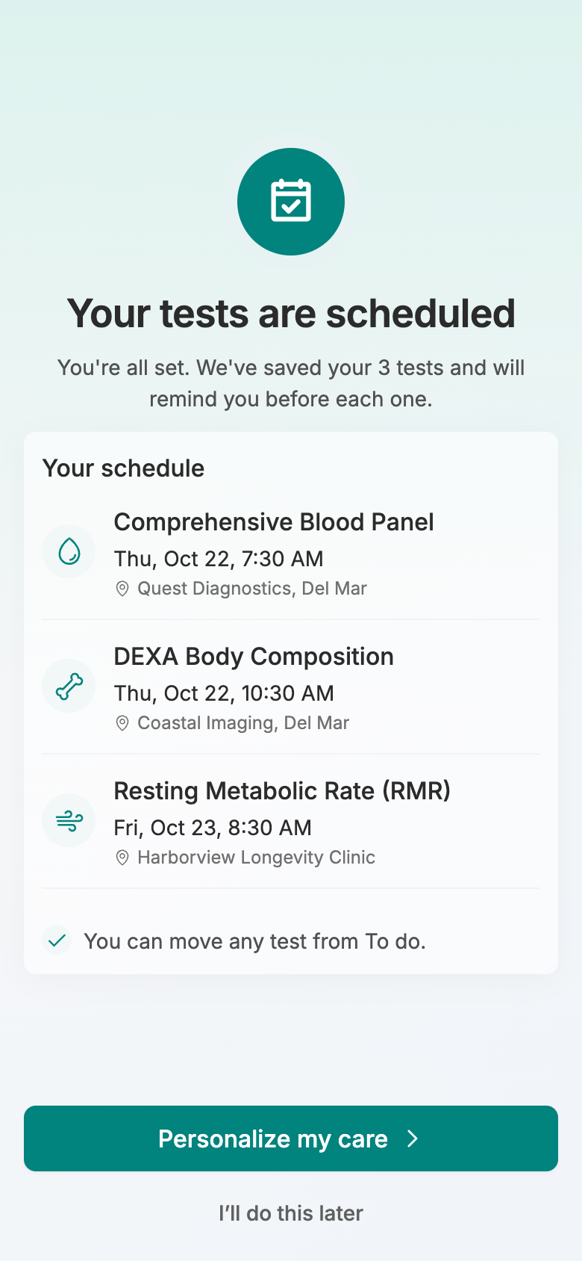
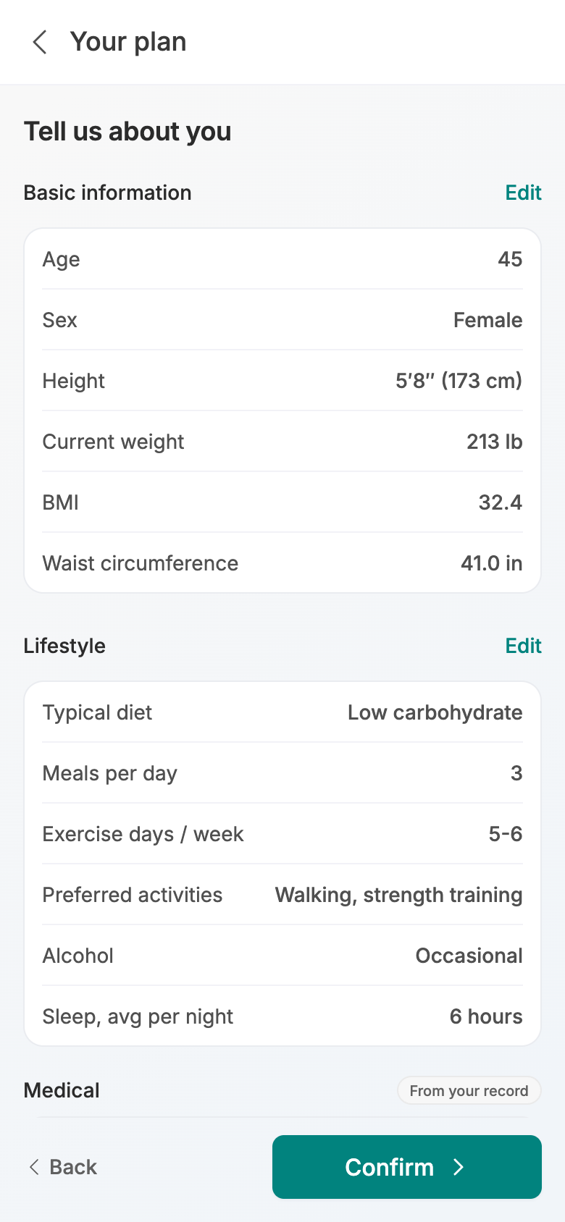
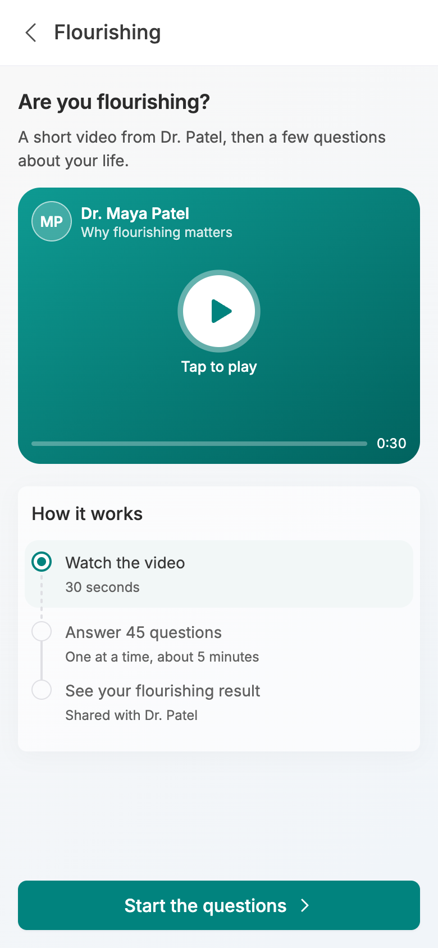
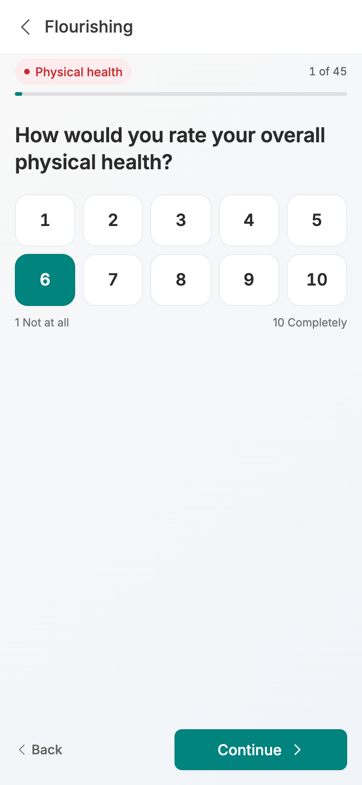
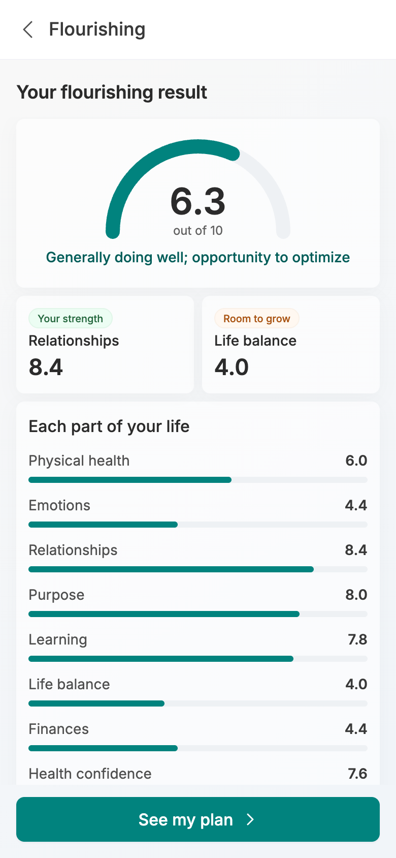
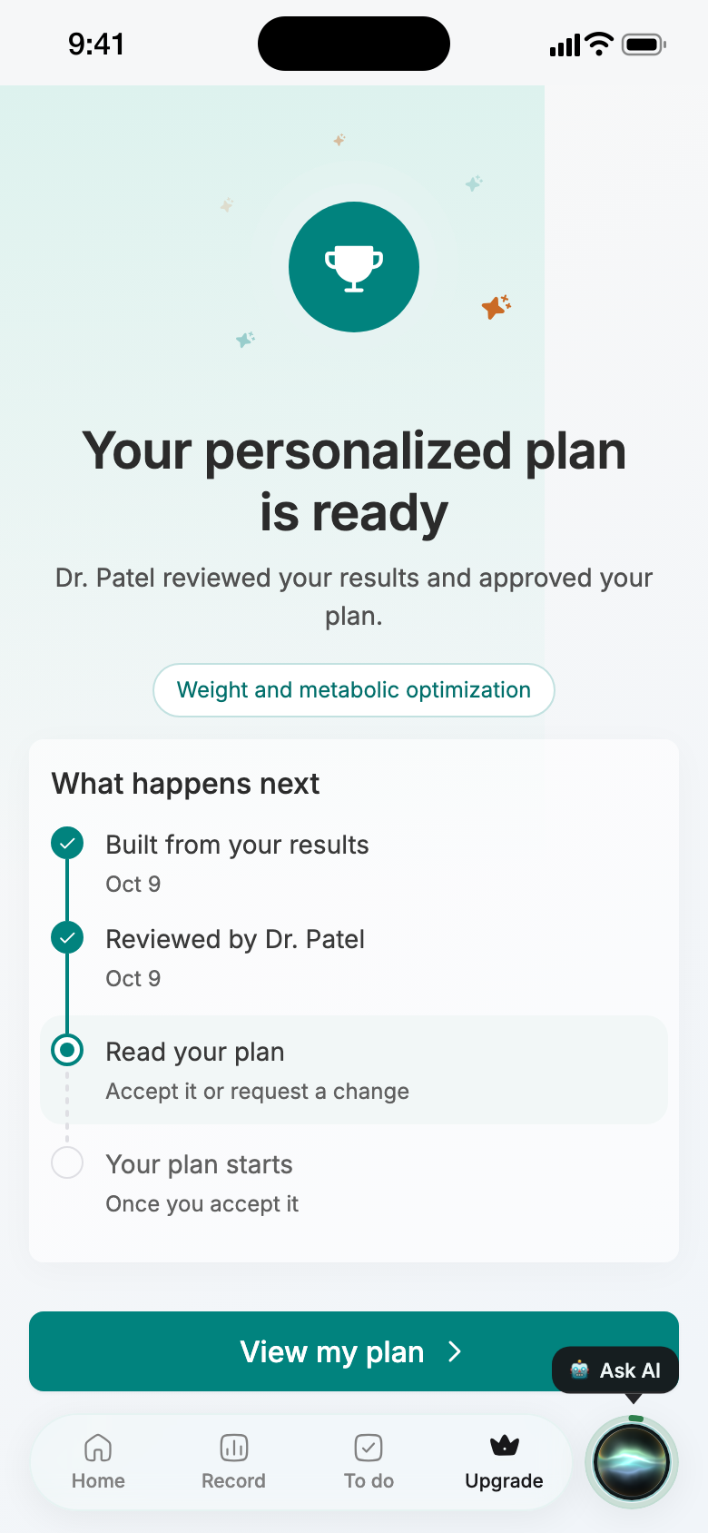
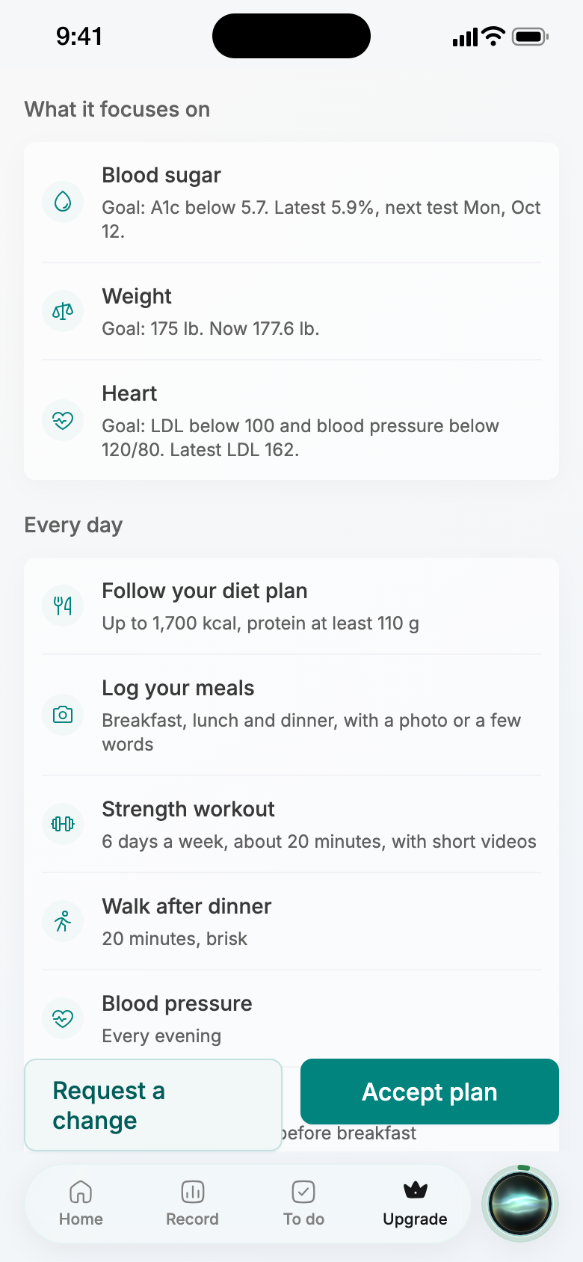
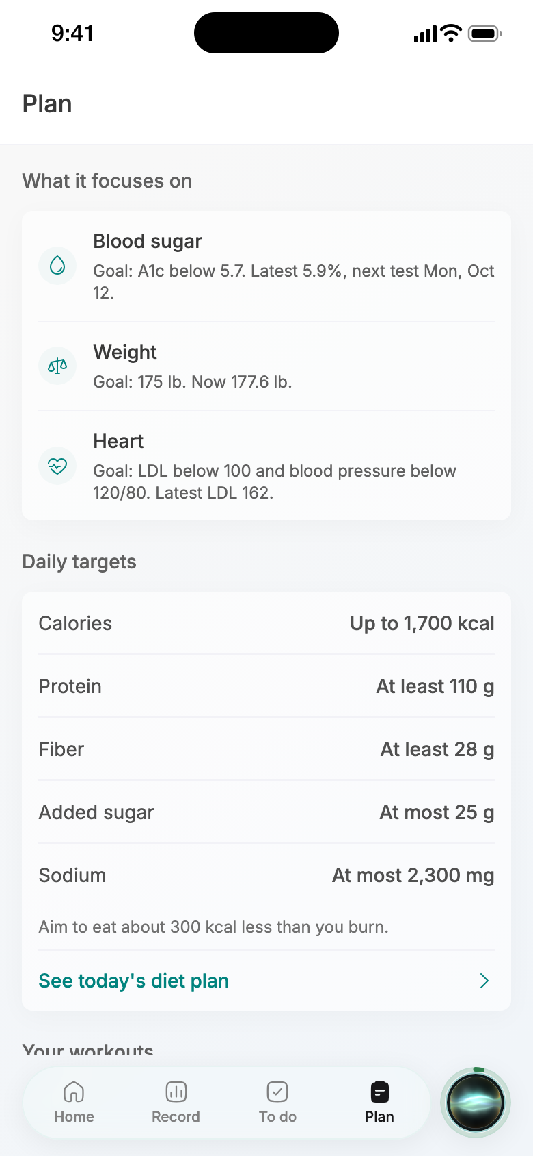
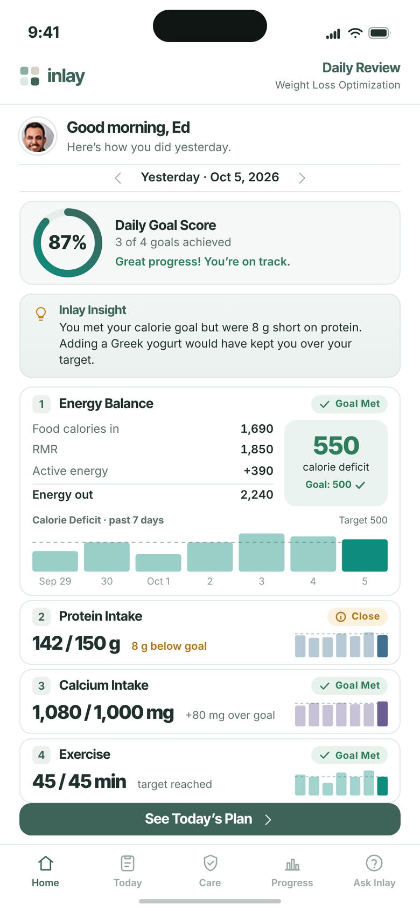
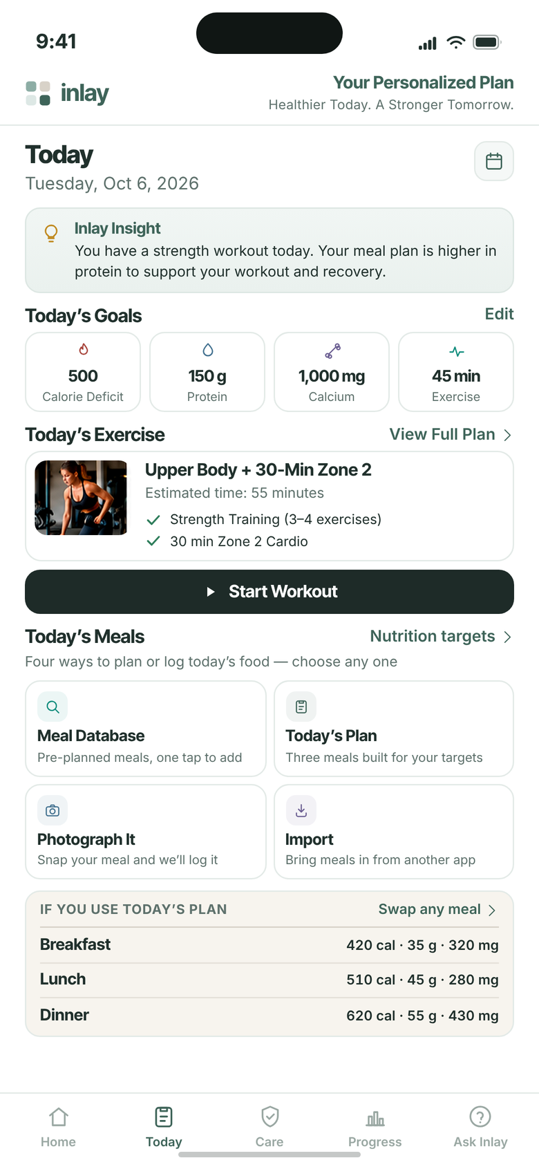
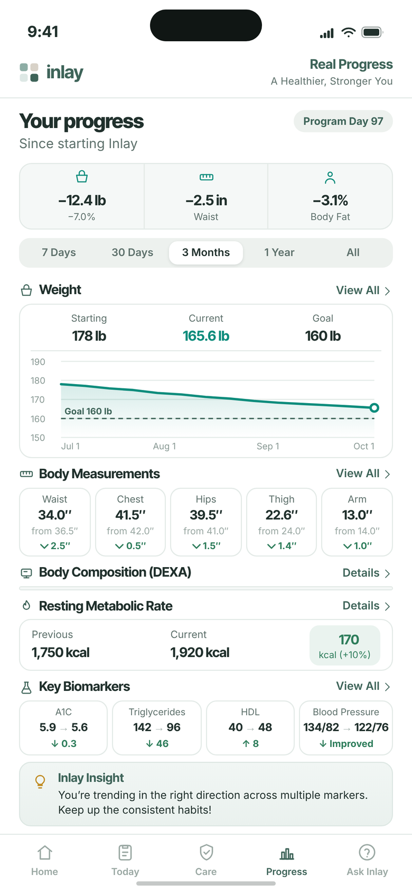
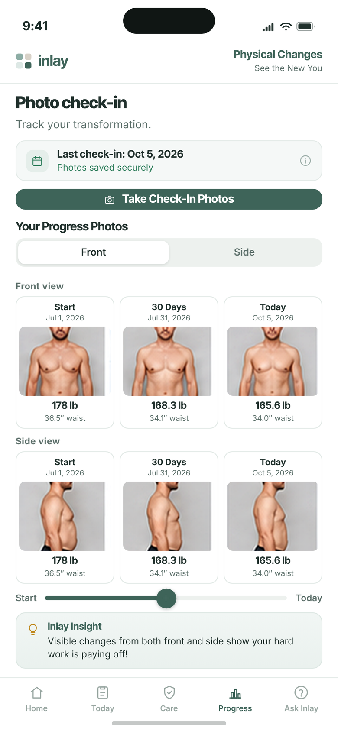
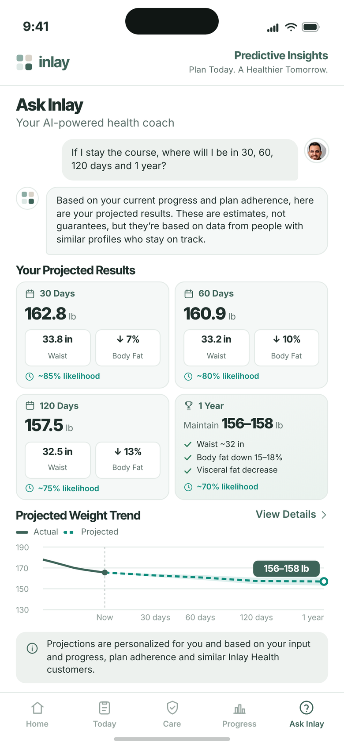
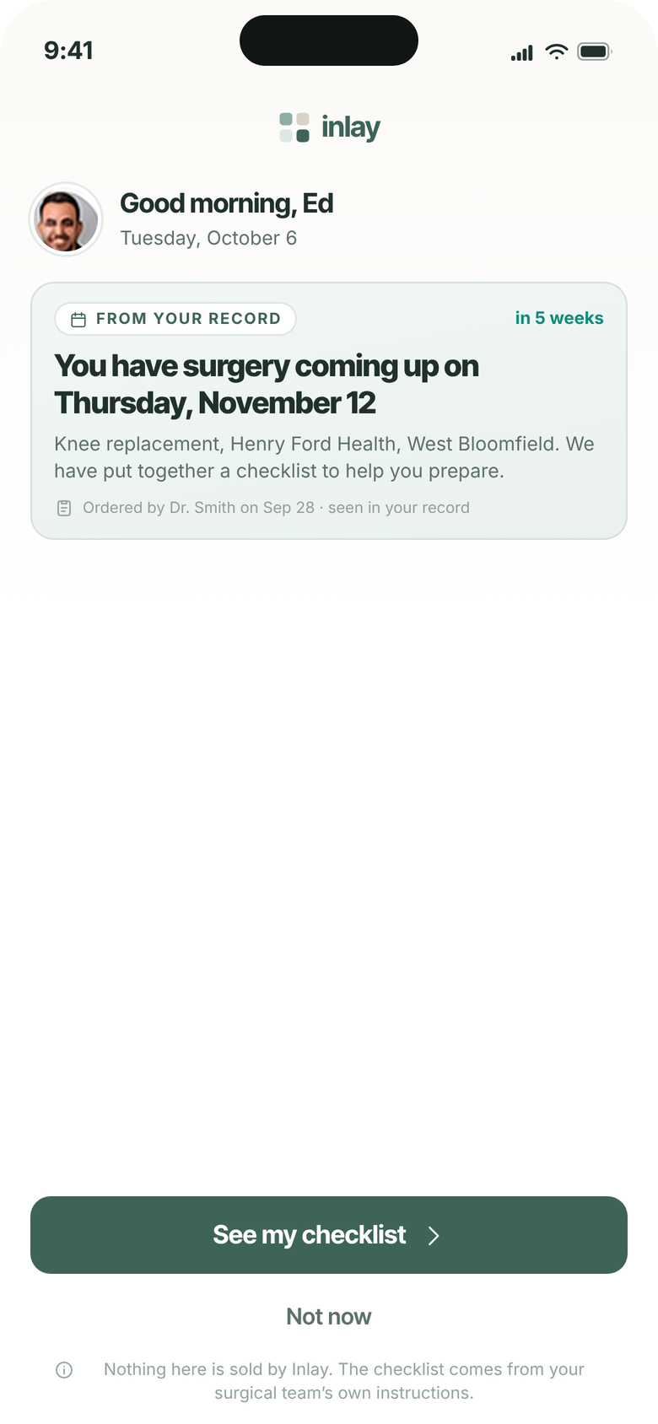
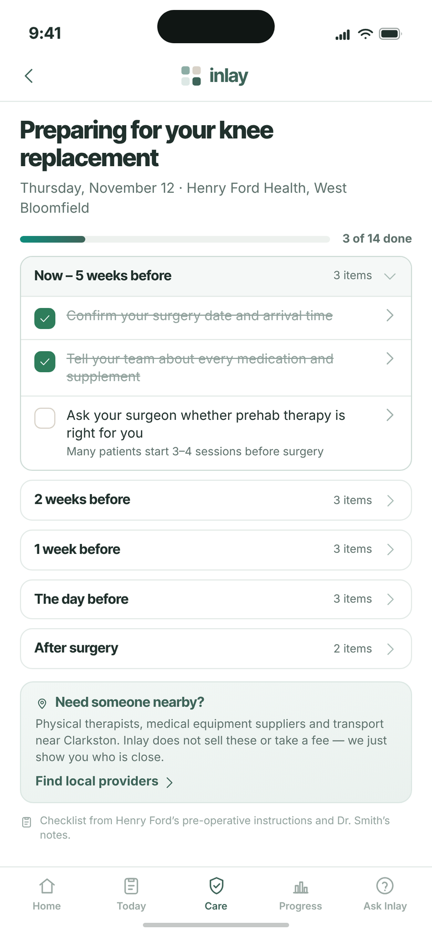
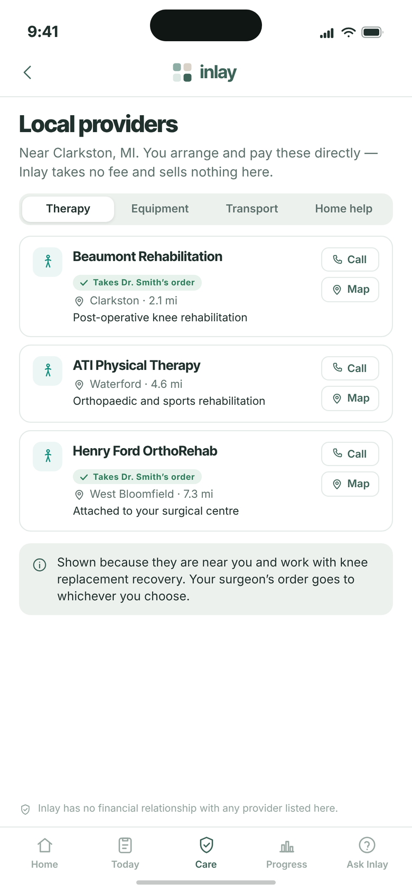



OPTIMIZATION PROGRAM · VERSION 15
The Patient Journey
54 screens, from the invitation email to the morning Inlay sees what is coming next.
01 Activate & Sign In
02 Identity & Consent
03 Onboarding
04 Dashboard
05 Free Plan & Upgrade
06 Daily Use
07 Inlay Care
54 screens · 7 stages · 19 new or changed after 16 Oct
Internal discussion draft · 19 October 2026 · updated after the 16 Oct review
Screens captured from the current local build

Slide 2

What changed since version 14
The record now shows its value before the upgrade, goals feed the plan picks, HSA or FSA pays, and a flourishing intro, questions and result follow payment.
New
10
Changed
8
Moved
1
Removed
1
13 Upcoming Appointments
14 New Medication
15 Trending the Wrong Way
16 Your Biological Age
17 What Is Driving It?
28 We Updated Your Plans
32 Payment Complete
37 Are You Flourishing?
38 Flourishing Question
39 Your Flourishing Result
12 Your Record Is Ready
26 Upgrade
27 What Would You Like to Improve?
30 Complete Your Enrollment
31 Payment Method
33 You're Enrolled
35 Your Tests Are Scheduled
36 Tell Us About You
18 Welcome, Liv
v14 30 Your Plan Is Being Reviewed
INLAY HEALTH · OPTIMIZATION PATIENT JOURNEY
SUMMARY
2

Slide 3
STAGE 01
Activate & Sign In
1
2
3
4
Four screens from the invitation email to a signed in patient. The clinic sends one code; the patient never invents a username or waits for a call.
Screens 1 to 4

Slide 4
1
STAGE 01 · ACTIVATE & SIGN IN
Invitation Email
One email, one code
The clinic invites the patient from the portal. The email carries the store links and a six digit activation code, and nothing else: no link to click, no ID, no password.
Sent in the clinic’s name: Harborview Longevity Clinic invites Olivia, signed by its clinic manager
The admit one card names the patient, the email and the code 731064, valid once, for 48 hours
A code that runs out is replaced by the clinic, so help stays with the practice the patient knows
INLAY HEALTH · OPTIMIZATION PATIENT JOURNEY
SCREEN 1 OF 54
4

Slide 5
2
STAGE 01 · ACTIVATE & SIGN IN
Activate Your Account
Email, birth date, one-time code
The code is checked against the email and date of birth the clinic already holds, so a code on its own cannot open anyone’s record.
Three fields and one button; the code is verified as soon as the sixth digit is typed
Date of birth is the second check, taken from the practice record rather than invented at sign up
“Already set a password? Sign in” keeps returning patients off this screen
INLAY HEALTH · OPTIMIZATION PATIENT JOURNEY
SCREEN 2 OF 54
5

Slide 6
3
STAGE 01 · ACTIVATE & SIGN IN
Create Your Password
The only thing the patient chooses
Once the code is accepted the patient sets a password, with the same rules as the web portals. There is no username to invent and no second factor to set up.
New password and confirmation, each with show and hide
Going back cancels the code, so a half finished activation cannot be reused
Face ID is offered later, from settings, once the patient is signed in
INLAY HEALTH · OPTIMIZATION PATIENT JOURNEY
SCREEN 3 OF 54
6

Slide 7
4
STAGE 01 · ACTIVATE & SIGN IN
Sign In
Straight back in
Straight after the password is created the email is already filled in, so the new password is all there is to type.
Returning patients land here too: email and password, or Face ID once it is turned on
Forgot password sits under the field rather than behind a menu
A session left idle for 15 minutes comes back to this screen
INLAY HEALTH · OPTIMIZATION PATIENT JOURNEY
SCREEN 4 OF 54
7

Slide 8
STAGE 02
Identity & Consent
5
6
7
The patient confirms who they are from the clinic's own record, then gives one consent before anything medical is read.
Screens 5 to 7

Slide 9
5
STAGE 02 · IDENTITY & CONSENT
Is This You?
Confirm, don’t type
The details come from the clinic’s record and are shown view only. They are what the national networks match the patient on, so they have to be the practice’s own.
Name, preferred name, sex and age first: who the patient is, the way they would recognise themselves
Date of birth, mobile, email and home address, then the clinic that shares the record
A From your clinic tag says where every field came from; one action, Continue
INLAY HEALTH · OPTIMIZATION PATIENT JOURNEY
SCREEN 5 OF 54
9

Slide 10
6
STAGE 02 · IDENTITY & CONSENT
Connect Your Health Records
Consent comes before any data
Nothing medical is read until the patient agrees. The screen says who sees the records, what is collected and for how long, in three lines rather than a legal page.
Who sees them: the patient and Harborview Longevity Clinic. What we collect: visits, labs and 7 more
The patient picks how long: 15 days, 1 month or 3 months, each with its end date
Two boxes, the authorization and the terms, with the full text of each one tap away
INLAY HEALTH · OPTIMIZATION PATIENT JOURNEY
SCREEN 6 OF 54
10

Slide 11
7
STAGE 02 · IDENTITY & CONSENT
Updates About Your Care
How Inlay may reach them
The second consent page covers contact about care: texts, calls and email. Agreeing here signs the consent and starts the record pull.
Three separate permissions, so a patient can take texts and decline calls
Messaging terms are linked from the text option, where carriers expect them
Agree and continue goes straight into the assistant’s first conversation
INLAY HEALTH · OPTIMIZATION PATIENT JOURNEY
SCREEN 7 OF 54
11

Slide 12
STAGE 03
Onboarding
8
9
10
11
12
13
Eight life questions while the record arrives, the record builds, then a short tour shows its value first: appointments, new medication, the trends going the wrong way, biological age and what drives it, ending on the 3 of 81 plan match.
14
15
16
17
18
Screens 8 to 18

Slide 13
8
STAGE 03 · ONBOARDING
About Your Life
Eight questions while the record arrives
Consent starts the record pull, and the wait is used for the patient’s life rather than their results: eight flourishing questions, about 90 seconds, no wrong answers.
“Eight questions, about 90 seconds” sets expectations before the first one
The eight areas are listed up front: physical, emotional, relationships, purpose, growth, balance, finances, health agency
Start, or Skip straight to the record; nothing is shared unless the patient sends it
INLAY HEALTH · OPTIMIZATION PATIENT JOURNEY
SCREEN 8 OF 54
13

Slide 14
9
STAGE 03 · ONBOARDING
Life Question
One area, one question, one scale
Each area gets its own screen: how would you rate your overall physical health, thinking about the past two weeks.
A 1 to 10 scale, from Very poor to Excellent, answered in one tap
Skip is always there, so no question stands between the patient and their record
Eight screens in all, about 90 seconds, while the record keeps building
INLAY HEALTH · OPTIMIZATION PATIENT JOURNEY
SCREEN 9 OF 54
14

Slide 15
10
STAGE 03 · ONBOARDING
Pick Three
What they most want to improve
The eight scores come back as one list, and the patient picks the three they would most like to improve.
Each area shows the patient’s own score, so the lowest ones stand out without a chart
Three picks, then Continue goes back to the record being built
The picks feed the plan match on the Upgrade tab and the Human Flourishing Index
INLAY HEALTH · OPTIMIZATION PATIENT JOURNEY
SCREEN 10 OF 54
15

Slide 16
11
STAGE 03 · ONBOARDING
Building Your Record
The record builds in front of them
Consent starts the pull from every provider the networks find. The screen tells it the way a patient thinks about it: a running count, one bar, then each kind of record landing.
Finding your providers first, then visits, conditions, medications, labs, vitals and the rest
The real pull can take minutes, so the patient may leave and is told when it is ready
Go to my dashboard stays off until there is something to show
INLAY HEALTH · OPTIMIZATION PATIENT JOURNEY
SCREEN 11 OF 54
16

Slide 17
12
STAGE 03 · ONBOARDING
Changed
Your Record Is Ready
168 records, then the tour
The finished record is summarised as before, but the button no longer jumps to the dashboard. It opens a short tour of what the record already does for the patient.
168 records from 3 providers: lab results, vitals, visits and everything else, each with its share
What changed
Ends in the record tour, not the dashboard: 16 Oct, show what the record does before anything else (v14 screen 12)
See what my record does replaces Go to my dashboard and opens Upcoming appointments
Saved as a step, so a patient who closes the app comes back to the tour, not a rebuild
INLAY HEALTH · OPTIMIZATION PATIENT JOURNEY
SCREEN 12 OF 54
17

Slide 18
13
STAGE 03 · ONBOARDING
New
Upcoming Appointments
Everything already booked
The first thing the record shows is what is already on the calendar: lab draws and visits together, by month, read from the patient's own record.
October: cardiology follow up Wed 21 with Pacific Heart, A1c and lipid panel Wed 28 at Quest Diagnostics
What changed
New: 16 Oct, record value comes first, starting with upcoming appointments
November: thyroid panel and vitamin D at Labcorp, then a metabolic panel and blood count at Quest
December 8: record review by Dr. Patel at Harborview Longevity Clinic; a mark says lab test or visit
INLAY HEALTH · OPTIMIZATION PATIENT JOURNEY
SCREEN 13 OF 54
18

Slide 19
14
STAGE 03 · ONBOARDING
New
New Medication
Every list, in one place
The medicines each provider's list brought into the record, grouped by where they came from. Where two lists disagree, an amber mark says so for the doctor to settle.
From your doctor: atorvastatin 20 mg, cetirizine, metformin 500 mg twice a day, fluticasone nasal spray
What changed
New: 16 Oct, record value first, new medication second
From Scripps Memorial: lisinopril 10 mg and amlodipine 5 mg, now visible to Dr. Patel
Atorvastatin is marked Doses differ: 20 mg on the doctor's list, 10 mg on the hospital's
INLAY HEALTH · OPTIMIZATION PATIENT JOURNEY
SCREEN 14 OF 54
19

Slide 20
15
STAGE 03 · ONBOARDING
New
Trending the Wrong Way
Four results moving away
After the value, the hard part: the results from the last 12 months that are moving away from the patient's range, each as a trend tile with its last readings.
LDL 162, up from 150, and triglycerides 188, up from 172, both from Quest
What changed
Moved into onboarding: 16 Oct order puts trends right after the record's value
Blood pressure 134/86, up from 131/84, and BMI 32.4, up from 31.1
Only what the record says, nothing about plans or prices; See my biological age moves on
INLAY HEALTH · OPTIMIZATION PATIENT JOURNEY
SCREEN 15 OF 54
20

Slide 21
16
STAGE 03 · ONBOARDING
New
Your Biological Age
53, against a calendar age of 45
One number on one age line: the biological age counts up from the calendar age, and the patient can drag along the line to compare any age with their own.
Estimated from your own results: 53, eight years above a calendar age of 45 from the clinic's birth date
What changed
New: 16 Oct, biological age follows the trends
A hollow dot for you, a solid one for your body, the gap between them shaded
The estimate is a labelled sample until the biological age model is approved; calendar age is real
INLAY HEALTH · OPTIMIZATION PATIENT JOURNEY
SCREEN 16 OF 54
21

Slide 22
17
STAGE 03 · ONBOARDING
New
What Is Driving It?
The results behind the number
These results are pushing your biological age above your real age. Each one is a result in the record that is out of range or moving the wrong way.
BMI 32.4 leads, taken from the record, measured at the August visit
What changed
New: 16 Oct, puts the numbers in longevity terms, with BMI from the record
Then LDL 162 and triglycerides 188, each with its status and trend, the same rows as the Record tab
No years per result until the model can weigh them; See plans that can help ends setup
INLAY HEALTH · OPTIMIZATION PATIENT JOURNEY
SCREEN 17 OF 54
22

Slide 23
18
STAGE 03 · ONBOARDING
Moved
Welcome, Liv
Three of 81 plans
The plan match now ends onboarding: setup finishes, Home opens, and the upgrade page slides over it, so back lands on Home.
Your record points to three of our 81 plans, one line instead of the AI plan match card
What changed
Moved: 16 Oct, the 3 of 81 match follows What is driving it, before the dashboard (v14 screen 20)
Lipid and cardiovascular (LDL 162, up 34), triglyceride and insulin (188, up 38), metabolic (BMI 32.4)
See all 81 plans, then Build my personalized plan, or Do it later
INLAY HEALTH · OPTIMIZATION PATIENT JOURNEY
SCREEN 18 OF 54
23

Slide 24
STAGE 04
Dashboard
19
20
21
22
23
The free record, every day: what needs attention, how results are moving, what is coming up, and an assistant that knows the record.
24
25
Screens 19 to 25

Slide 25
19
STAGE 04 · DASHBOARD
First Look: App Tour
Five tabs, explained once
The first time Home opens, a three step tour names the tabs. It runs once, over the live dashboard, and can be skipped.
Home is your day, To do lists what is open, Record holds results, Connect links doctors and devices, Upgrade shows what a membership adds
The tour points at the floating tab bar and the assistant circle beside it
Skip ends it at once; Next walks through the remaining two steps
INLAY HEALTH · OPTIMIZATION PATIENT JOURNEY
SCREEN 19 OF 54
25

Slide 26
20
STAGE 04 · DASHBOARD
Home
What needs them, first
The free home leads with what the patient has to act on, then how their results are moving. Every trend is drawn from their own record.
3 things need you: a muted red card for pending actions, one tap from the To do list
Four trend tiles: BMI 32.4, LDL 162 and triglycerides 188 above target, ferritin 46 in range
Your connections sits under the alert: health records and devices, with None connected until the patient links one
INLAY HEALTH · OPTIMIZATION PATIENT JOURNEY
SCREEN 20 OF 54
26

Slide 27
21
STAGE 04 · DASHBOARD
Home: Further Down
Upcoming, new, and medicines
Below the trends, Home shows what is booked, what has just arrived in the record, and the medicines on file.
Cardiology follow up on Oct 21 with Dr. Lee at Pacific Heart
New in your record: urgent care and cardiology visits outside the clinic, now visible to Dr. Patel
Records differ is flagged on atorvastatin; Ask about your results shows 25% of the week’s AI credit used
INLAY HEALTH · OPTIMIZATION PATIENT JOURNEY
SCREEN 21 OF 54
27

Slide 28
22
STAGE 04 · DASHBOARD
Record
Every result, with its trend
The Record tab holds the whole record: biomarkers, tests and orders, medicines, conditions, visits and more, with results grouped by body system.
Category pills on top, body system chips under them: blood sugar, cholesterol, heart and weight
Each row has the value, its status, a small trend and the date; out of range results come first
Add to your record takes a result from outside the network
INLAY HEALTH · OPTIMIZATION PATIENT JOURNEY
SCREEN 22 OF 54
28

Slide 29
23
STAGE 04 · DASHBOARD
Result Detail
LDL 162, and how it got there
Opening a result shows the latest value against its range, every past reading on one chart, and where each one came from.
Out of range and trending up: 162 mg/dL against a target under 100, up from 128 in April 2022
Four results on the chart, each listed with its date and source, Quest Diagnostics
What a plan adds is listed further down, and the page says plainly that it stays free
INLAY HEALTH · OPTIMIZATION PATIENT JOURNEY
SCREEN 23 OF 54
29

Slide 30
24
STAGE 04 · DASHBOARD
To Do
What is open, in order
Care gaps, bookings and checks in one list, split into overdue, upcoming and completed.
2 overdue: book a mammogram, due Apr 4, and a follow up visit after urgent care on Jun 3
Check 2 medicines; an echocardiogram and a repeat A1c and lipid panel wait to be booked
Dr. Patel’s record review on Dec 8 is listed with No visit needed
INLAY HEALTH · OPTIMIZATION PATIENT JOURNEY
SCREEN 24 OF 54
30

Slide 31
25
STAGE 04 · DASHBOARD
Ask Inlay
An assistant that knows the record
The assistant opens on four plain starting points. Credit is shown as a share of the week used, never as a count of questions.
Explain one of my results, prepare for my next visit, a question about my medicines, something is bothering me
25% of this week’s AI credit used, on a strip above the composer
General information, not medical advice, stated under every conversation
INLAY HEALTH · OPTIMIZATION PATIENT JOURNEY
SCREEN 25 OF 54
31

Slide 32
STAGE 05
Free Plan & Upgrade
26
27
28
29
30
31
From the Upgrade tab to an accepted plan: the plan match, the patient's own goals feeding the plan picks, enrollment and HSA or FSA payment with an itemized receipt, test booking, then the flourishing video, questions and result.
32
33
34
35
36
37
Screens 26 to 43
38
39
40
41
42 to 43

Slide 33
26
STAGE 05 · FREE PLAN & UPGRADE
Changed
Upgrade
The same welcome, any time
The Upgrade tab repeats the welcome the patient saw at the end of onboarding: the AI plan match, the three plans and one way forward.
AI plan match: 81 plans on file, 3 your record supports, each with the number behind it
What changed
Repeats the onboarding welcome per 16 Oct; physician note removed, Do it later added (v14 screen 20)
The other 78 are not a fit for your record today, with See all 81
The physician note is gone; Do it later now sits under Build my personalized plan
INLAY HEALTH · OPTIMIZATION PATIENT JOURNEY
SCREEN 26 OF 54
33

Slide 34

27
Goals picked
Add your own goal
STAGE 05 · FREE PLAN & UPGRADE
Changed
What Would You Like to Improve?
Their own goals, step 1 of 4
Goals are now their own step: nine goals in one list, several can be picked, and the ones the record backs start ticked.
Lose weight, metabolic health, cholesterol and heart, muscle, bone, sleep, energy, fitness and VO₂ max, kidney
Weight, metabolic health and cholesterol start ticked, because the record backs them
What changed
Goals are a separate step that feeds the plan picks: 16 Oct decision (v14 screen 22)
INLAY HEALTH · OPTIMIZATION PATIENT JOURNEY
SCREEN 27 OF 54
34

Slide 35

28
Goals add two plans
A plan the patient added
STAGE 05 · FREE PLAN & UPGRADE
New
We Updated Your Plans
Your goals add a plan
The plans the record points to, then what the goals added on top, up to five in all. Each row says where it came from.
Lipid control, insulin sensitivity and metabolic health come first, each tagged Record
Based on your goals, we added two: Run a 10k, and Better sleep with a sleep study to set its starting point
What changed
New: 16 Oct, goals feed the AI plan picks and the patient can add plans
INLAY HEALTH · OPTIMIZATION PATIENT JOURNEY
SCREEN 28 OF 54
35

Slide 36
29
STAGE 05 · FREE PLAN & UPGRADE
Establish Your Baseline
What the record is missing
Step 2 of 4. Three standard tests give the plan its starting point, each priced, each with a Why?
$189 blood panel, $149 DEXA, $129 RMR: 3 of 3 tests, $467
All three ticked to start; any of them can be cleared
The screen says why the tests are needed to personalize the plan
INLAY HEALTH · OPTIMIZATION PATIENT JOURNEY
SCREEN 29 OF 54
36

Slide 37
30
STAGE 05 · FREE PLAN & UPGRADE
Changed
Complete Your Enrollment
Monthly or yearly, step 3 of 4
The plan named from the goals, monthly or yearly billing, and the baseline tests, all priced before payment.
Yearly $1,080, or $100 a month; yearly members get 10% off their tests
What changed
Simpler: the monthly versus yearly note removed; tests priced before payment per 16 Oct (v14 screen 26)
3 tests $467, annual member discount $46.70 off, total due today $1,500.30
The note comparing the two ways to pay is gone; the toggle says Save 10% on its own
INLAY HEALTH · OPTIMIZATION PATIENT JOURNEY
SCREEN 30 OF 54
37

Slide 38
31
STAGE 05 · FREE PLAN & UPGRADE
Changed
Payment Method
HSA or FSA, like any card
Step 4 of 4. An HSA or FSA card is now a way to pay of its own, beside credit card, Apple Pay and Google Pay.
Four ways to pay, two to a row: Credit card, HSA or FSA, Apple Pay, Google Pay
What changed
Adds HSA or FSA as a way to pay: 16 Oct decision (v14 screen 27)
HSA or FSA takes the same fields as a card, under HSA or FSA card number, secure and encrypted
Total due today $1,500.30; Complete enrollment stays off until the terms are ticked
INLAY HEALTH · OPTIMIZATION PATIENT JOURNEY
SCREEN 31 OF 54
38

Slide 39
32
STAGE 05 · FREE PLAN & UPGRADE
New
Payment Complete
Paid, with a receipt
Once the payment goes through, a popup confirms it before the enrolled page: the amount, the card and an itemized receipt to keep.
$1,500.30 paid to Inlay Health with the HSA or FSA card ending 4242, today's date and the receipt number
What changed
New: 16 Oct, an itemized receipt for HSA and FSA claims
Download receipt itemizes the membership, each test and the yearly discount, as HSA and FSA administrators ask
Continue opens You're enrolled
INLAY HEALTH · OPTIMIZATION PATIENT JOURNEY
SCREEN 32 OF 54
39

Slide 40
33
STAGE 05 · FREE PLAN & UPGRADE
Changed
You're Enrolled
What happens next, in order
The membership has started, and the payment is already confirmed. The screen lists each next step with the physician named.
Enrolled in Inlay today, then Schedule your tests
What changed
Drops the no charge until approval line: 16 Oct, no physician approval hold (v14 screen 28)
The line No charge until Dr. Patel approves your plan is gone: the patient has paid
Schedule my tests, or Schedule later, which keeps the tests in To do
INLAY HEALTH · OPTIMIZATION PATIENT JOURNEY
SCREEN 33 OF 54
40

Slide 41
34
STAGE 05 · FREE PLAN & UPGRADE
Schedule Tests
A day and a time for each test
Each paid test with its place, a date and a time. Confirm schedule books them all at once.
Blood panel at Quest Diagnostics, DEXA at Coastal Imaging, RMR at Harborview Longevity Clinic
Select date opens open weekdays, then the times for that day
Confirm schedule books all three
INLAY HEALTH · OPTIMIZATION PATIENT JOURNEY
SCREEN 34 OF 54
41

Slide 42
35
STAGE 05 · FREE PLAN & UPGRADE
Changed
Your Tests Are Scheduled
Booked, then flourishing
Confirm schedule lands here: every test with its day, time and place, and a reminder before each one.
Blood panel at Quest Diagnostics, DEXA at Coastal Imaging, RMR at Harborview Longevity Clinic
What changed
Leads to the new flourishing questions; approval line removed, 16 Oct (v14 screen 29a)
You can move any test from To do; the no charge until approval line is gone
Personalize my care now leads through Tell us about you to the flourishing video and questions
INLAY HEALTH · OPTIMIZATION PATIENT JOURNEY
SCREEN 35 OF 54
42

Slide 43
36
STAGE 05 · FREE PLAN & UPGRADE
Changed
Tell Us About You
From the record, then confirmed
The profile as the record has it, in three blocks. The patient confirms it, and Confirm now opens Are you flourishing?
Basic information: age 45, weight 213 lb, BMI 32.4, waist 41 in
What changed
Confirm opens the new flourishing intro, per 16 Oct (v14 screen 29b)
Lifestyle edits in a sheet; medical is read from the record, never retyped
Confirm opens the flourishing video instead of the assistant's chat
INLAY HEALTH · OPTIMIZATION PATIENT JOURNEY
SCREEN 36 OF 54
43

Slide 44

37
Before the video
Video playing
STAGE 05 · FREE PLAN & UPGRADE
New
Are You Flourishing?
A short video from Dr. Patel
Why first, then what: a 30 second video from Dr. Patel on why flourishing matters, then how the questions work.
Your health is more than your numbers: the captions play over the video, with play, pause and replay
How it works: watch the video, answer 45 questions, one at a time, about 5 minutes, see your result
What changed
New: 16 Oct, a flourishing intro with a video under 60 seconds (v14 screen 29c)
INLAY HEALTH · OPTIMIZATION PATIENT JOURNEY
SCREEN 37 OF 54
44

Slide 45
38
STAGE 05 · FREE PLAN & UPGRADE
New
Flourishing Question
One question, ten buttons
The flourishing questions as a questionnaire, not a chat: one question a page, the part of life as a coloured chip, 1 of 45 and a thin bar.
A 1 to 10 scale as ten big buttons, 1 Not at all to 10 Completely; a tap moves on
What changed
Replaces the chat: 16 Oct, mandatory questions with free text or voice answers (v14 screen 29c)
Explain your answer: the patient speaks or types what is behind it, kept for the physician
Every answer saved as it is made; the one optional question has Prefer not to answer
INLAY HEALTH · OPTIMIZATION PATIENT JOURNEY
SCREEN 38 OF 54
45

Slide 46

39
Overall and extremes
Each part of life
STAGE 05 · FREE PLAN & UPGRADE
New
Your Flourishing Result
A score per part of life
The overall score fills a half dial out of 10, with what it means in one line, then each of the eight parts of life as its own bar.
Your strength and Room to grow name the highest and lowest parts of life, with their scores
Each part of your life: physical health, emotions, relationships, purpose and four more
What changed
New: 16 Oct, a flourishing result per domain
INLAY HEALTH · OPTIMIZATION PATIENT JOURNEY
SCREEN 39 OF 54
46

Slide 47
40
STAGE 05 · FREE PLAN & UPGRADE
Your Plan Is Ready
Approved, and attributed
Shown once, the first time the Plan tab opens after Dr. Patel sends version 1.
Dr. Patel reviewed your results and approved your plan
The next step is the patient’s: read the plan, then accept it or request a change
View my plan opens the plan itself
INLAY HEALTH · OPTIMIZATION PATIENT JOURNEY
SCREEN 40 OF 54
47

Slide 48
41
STAGE 05 · FREE PLAN & UPGRADE
Read Your Plan
Nothing starts until they accept
The full plan, with two actions side by side over the tab bar: Request a change and Accept plan.
Goals: A1c below 5.7, weight 175 lb, LDL below 100 and blood pressure below 120/80
Every day: a diet plan up to 1,700 kcal, logged meals, strength workouts and a walk after dinner
Request a change sits beside Accept plan, never behind a menu
INLAY HEALTH · OPTIMIZATION PATIENT JOURNEY
SCREEN 41 OF 54
48

Slide 49

42 to 43
If they accept
If they ask for a change
STAGE 05 · FREE PLAN & UPGRADE
Accept or Request a Change
Two ways forward
Accepting starts the plan at once. A change request sends the patient’s own words to Dr. Patel.
Accept: the Plan tab becomes the live plan, with daily targets and today’s diet plan
Request a change: one question, What would you like changed?, sent to Dr. Patel
Once accepted, the day starts with Yesterday, the next screen in this journey
INLAY HEALTH · OPTIMIZATION PATIENT JOURNEY
SCREENS 42 to 43 OF 54
49

Slide 50
STAGE 06
Daily Use
44
45
46
47
48
Five screens that run every day: yesterday's score, today's plan, measured progress, photographic evidence and the projection that renews the subscription.
Screens 44 to 48

Slide 51
44
STAGE 06 · DAILY USE
Yesterday: How Did I Do?
The first screen every morning
One score, one insight and four goals — the whole of yesterday in a single screen, with no scrolling required.
87% daily goal score, 3 of 4 goals achieved
Energy balance reconciles on screen: 2,240 kcal out, 1,690 in, a 550 deficit against a 500 goal
The insight names the one miss — 8 g of protein — and what would have closed it
INLAY HEALTH · OPTIMIZATION PATIENT JOURNEY
SCREEN 44 OF 54
51

Slide 52
45
STAGE 06 · DAILY USE
Today: Personalized Plan
Four ways to eat the plan
A fixed menu is the fastest way to lose a patient. The day’s targets stay fixed — 500 cal deficit, 150 g protein, 1,000 mg calcium, 45 min exercise — but the food itself can come from four different places.
Meal database and today’s plan both add in one tap, already costed in calories, protein and calcium
Photograph It covers the meal that was never in anyone’s plan; Import takes the patient who already tracks elsewhere
The built plan stays visible but optional: breakfast 420 cal, lunch 510, dinner 620, with any meal swappable
INLAY HEALTH · OPTIMIZATION PATIENT JOURNEY
SCREEN 45 OF 54
52

Slide 53
46
STAGE 06 · DAILY USE
Progress
Day 97
The screen the patient shows other people — and the one that renews the subscription.
−12.4 lb, −2.5 in at the waist, −3.1% body fat since starting
Biomarkers moved: A1C 5.9→5.6, triglycerides 142→96, HDL 40→48, BP 134/82→122/76
RMR up 170 kcal (+10%) — measured proof that lean mass was preserved through the loss
INLAY HEALTH · OPTIMIZATION PATIENT JOURNEY
SCREEN 46 OF 54
53

Slide 54
47
STAGE 06 · DAILY USE
Photo Check-In
Evidence they can see
Front and side, three dates, with weight and waist under each frame.
Jul 1 — 178 lb · Jul 31 — 168.3 lb · Oct 5 — 165.6 lb
Photographs stored securely; the comparison slider is the moment patients share
Visible change is what holds a subscription together when the scale stalls
INLAY HEALTH · OPTIMIZATION PATIENT JOURNEY
SCREEN 47 OF 54
54

Slide 55
48
STAGE 06 · DAILY USE
Ask Inlay — Predictive Insights
Where this goes if they stay
The retention screen. It answers the question every patient asks at month three.
30 days 162.8 lb · 60 days 160.9 lb · 120 days 157.5 lb · 1 year maintain 156–158 lb
Every projection carries a likelihood: 85%, 80%, 75% and 70%
Framed as estimates drawn from similar patients, never as a promise
INLAY HEALTH · OPTIMIZATION PATIENT JOURNEY
SCREEN 48 OF 54
55

Slide 56
STAGE 07
Inlay Care
49
50
51
52
53
The app sees the surgery in the record and hands the patient a checklist drawn from their own surgical team’s instructions, with a directory of who is nearby. None of that is sold. Longevity Care, the elective screening catalogue, remains a paid Inlay product.
54
Screens 49 to 54

Slide 57
49
STAGE 07 · INLAY CARE
First Screen — Surgery Detected
Proof that we know them
When Inlay sees the surgery in the record, this takes the screen before Home. It says one thing, and that one thing is the whole argument for the free record.
“You have surgery coming up on Thursday, November 12” — named, dated, five weeks ahead
Ordered by Dr. Smith on Sep 28, and the screen says so, because the source is what makes it credible
Nothing is sold here. The line under the button says the checklist comes from the surgical team, not from us
INLAY HEALTH · OPTIMIZATION PATIENT JOURNEY
SCREEN 49 OF 54
57

Slide 58
50
STAGE 07 · INLAY CARE
Preparation Checklist
Fourteen things, in the right order
Grouped by when each one matters rather than listed flat, so the patient sees the three things to do now instead of a wall of instructions five weeks early.
3 of 14 done, with the current group open and the rest collapsed until their time comes
The content is Henry Ford’s own pre-operative instructions and Dr. Smith’s notes — Inlay carries it, Inlay did not write it
One box at the foot for local providers, worded as help rather than as a storefront
INLAY HEALTH · OPTIMIZATION PATIENT JOURNEY
SCREEN 50 OF 54
58

Slide 59
51
STAGE 07 · INLAY CARE
Local Providers
Who is nearby, and nothing else
Therapy, equipment, transport and home help near Clarkston. The patient arranges and pays directly; Inlay takes no fee and never touches the transaction.
Two of the three clinics already accept Dr. Smith’s order — the one thing only we would know
Call and Map. No price, no booking, no checkout
“Inlay has no financial relationship with any provider listed here” sits at the foot of the screen
INLAY HEALTH · OPTIMIZATION PATIENT JOURNEY
SCREEN 51 OF 54
59

Slide 60
52
STAGE 07 · INLAY CARE
Checklist Item
Why, not just what
Opening an item gives the reason behind it, which is what turns a list of instructions into something a patient actually follows.
Why it matters, what to do, and what else is worth arranging while they are at it
Dated and specific: collected from Henry Ford West Bloomfield on the afternoon of November 12
The transport box appears here too, because this is the moment the patient needs it
INLAY HEALTH · OPTIMIZATION PATIENT JOURNEY
SCREEN 52 OF 54
60

Slide 61
53
STAGE 07 · INLAY CARE
Longevity Care
For the patient who comes looking
The elective side, and the one part of Inlay Care that is still sold. Nothing here is triggered by an event — it is for the well patient who wants to find something early.
“You are well today” is the opening line, which is what makes the rest of the page credible
Suggested for you sits above the catalogue, drawn from age, record and family history
Suggested is worded as options to consider, never as recommendations
INLAY HEALTH · OPTIMIZATION PATIENT JOURNEY
SCREEN 53 OF 54
61

Slide 62
54
STAGE 07 · INLAY CARE
Longevity Care — Test Detail
What it cannot tell you
Every elective test carries the same six disclosures, the limits included. This is the page that protects the brand when a screening result turns out to be nothing.
$949 standard, $854 for members, with the request routed to the physician rather than left to the patient
The physician writes and holds the order; Inlay only connects the patient to the provider
“It does not rule cancer out, and a positive signal is not a diagnosis” sits on the page, not in the terms
INLAY HEALTH · OPTIMIZATION PATIENT JOURNEY
SCREEN 54 OF 54
62

Slide 63

Taken out of the journey
Per the 16 Oct call there is no physician approval hold: the patient accepts the plan and the doctor is informed.
Removed
Your Plan Is Being Reviewed
Was v14 screen 30
Removed: 16 Oct, no physician approval hold; the patient accepts and the doctor is informed
INLAY HEALTH · OPTIMIZATION PATIENT JOURNEY
REMOVED
63

Slide 64
STILL OPEN
Decisions these screens wait on
HSA eligibility
Flourishing questions and licence
HOL to confirm with an ERISA attorney before the HSA or FSA option and receipt ship.
Question set per domain under Dr. Blanchard's review; Harvard licence and benchmark data with HOL.
Rejecting every plan
Biological age model
What happens when a patient declines all plans: a refund was suggested, nothing decided.
The age shown is a labelled sample until the model and its inputs are approved.
Goal-setting questions
Free versus paid
Dr. Blanchard is writing about 10 SMART goal questions to replace the goal list.
Which features stay free (trends, appointments, medicines) still to be tested and decided.

